Slide 1


OK-AIR:
Advancing Indoor-environment Research for Children in Oklahoma
Notes:
Thank you for the opportunity to discuss our project focused on air quality in ECE settings in OK.

Slide 2








OK-AIR: Interdisciplinary Approach
Diane Horm, PhD, Founding Director, Early Childhood Education (ECE) Institute at OU–Tulsa; Professor of ECE
Changjie Cai, PhD, Founding Director, Children’s Environmental Health Center in the U.S. Southern Plains, OU-HS; Assistant Professor of Occupational
and Environmental Health
Barbara Fuhrman, Epidemiologist, University of Pittsburgh; Assistant Professor of Epidemiology
Jason Vogel, Director, Oklahoma Water Survey, OU-Norman; Professor of Civil Engineering & Environmental Science
Notes:
We have an interdisciplinary team who bring different perspectives and expertise to the project.

Slide 3
OK-AIR: Why Important?
Air quality in ECE settings is under-researched; but young children are likely to be the most vulnerable to poor air quality.
Positive health provides the foundation for children to engage and benefit from all the ECE classroom has to offer in supporting their growth, development, and learning.
We have a current crisis in teacher shortages, thus their health and perceptions about their work environment are paramount.
Indoor air quality is another aspect of classroom/program quality; and environmental justice!

Slide 4
Scoping Review (47 studies included)
There is a paucity in the published work related to children’s non-health outcomes and indoor air quality.
0 of the articles we reviewed were in journals related to early childhood education, despite almost half of the studies taking place in schools or child-care centers.
Many of the studies point to a strong contribution of air quality to a child’s overall wellbeing and health.
Notes:
This aspect of our work was led by Dr. Craig Van Pay with assistance by ECE and Public Health graduate students.
After extensive searching, our team identified 47 published studies. Of those studies, ……..review pie charts.
13 studies published in the US; most work done in other countries
12 studies focused on preschool settings; most done in children’s homes
15 studies tried to change or improve air quality; more just recorded it – our OK-AIR studies does both
90% of the studies focus on asthma or respiratory symptoms as the primary outcomes; we were interested in children’s absences from ECE programs and potential impacts on SE development.

Slide 5
OK-AIR: Purpose
The overall goals of OK-AIR are to:
  Determine if the reliable use of air cleaning devices improves the classroom air quality in ECE settings;
  Investigate the feasibility of using inexpensive air cleaning devices in ECE classrooms;
  Assess if better air quality in ECE classrooms results in positive impacts on teachers’ health and children’s health and behavior (i.e., absences).
Our OK-AIR Project is a test of the potential for low-cost and low-burden interventions (air filters, UV scrubbers) to have significant and meaningful impacts on teachers’ and children’s health and children’s development.
Notes:
We also have economist working with us to do cost/benefit analysis.

Slide 6
OK-AIR Participants
Participating sites (for 2023-24) include 5 Head Start/Early Head Start Programs operated by 3 agencies:
  Rural areas: two sites
  Semi-rural/sub-urban: one site
  Urban areas: two sites
Across these 5 participating sites, we have consented/enrolled:
  206 children between the ages of 1 and 4
  56 teachers
  5 site directors

Slide 7
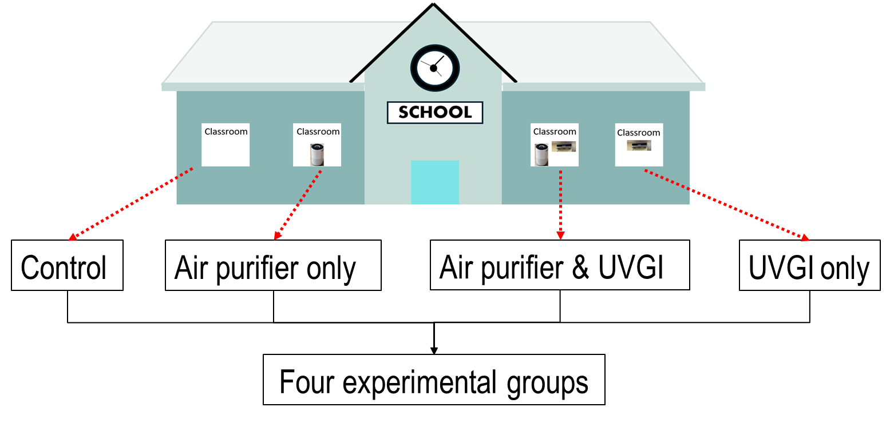
Experimental Design:
2×2 randomized trial

Slide 8
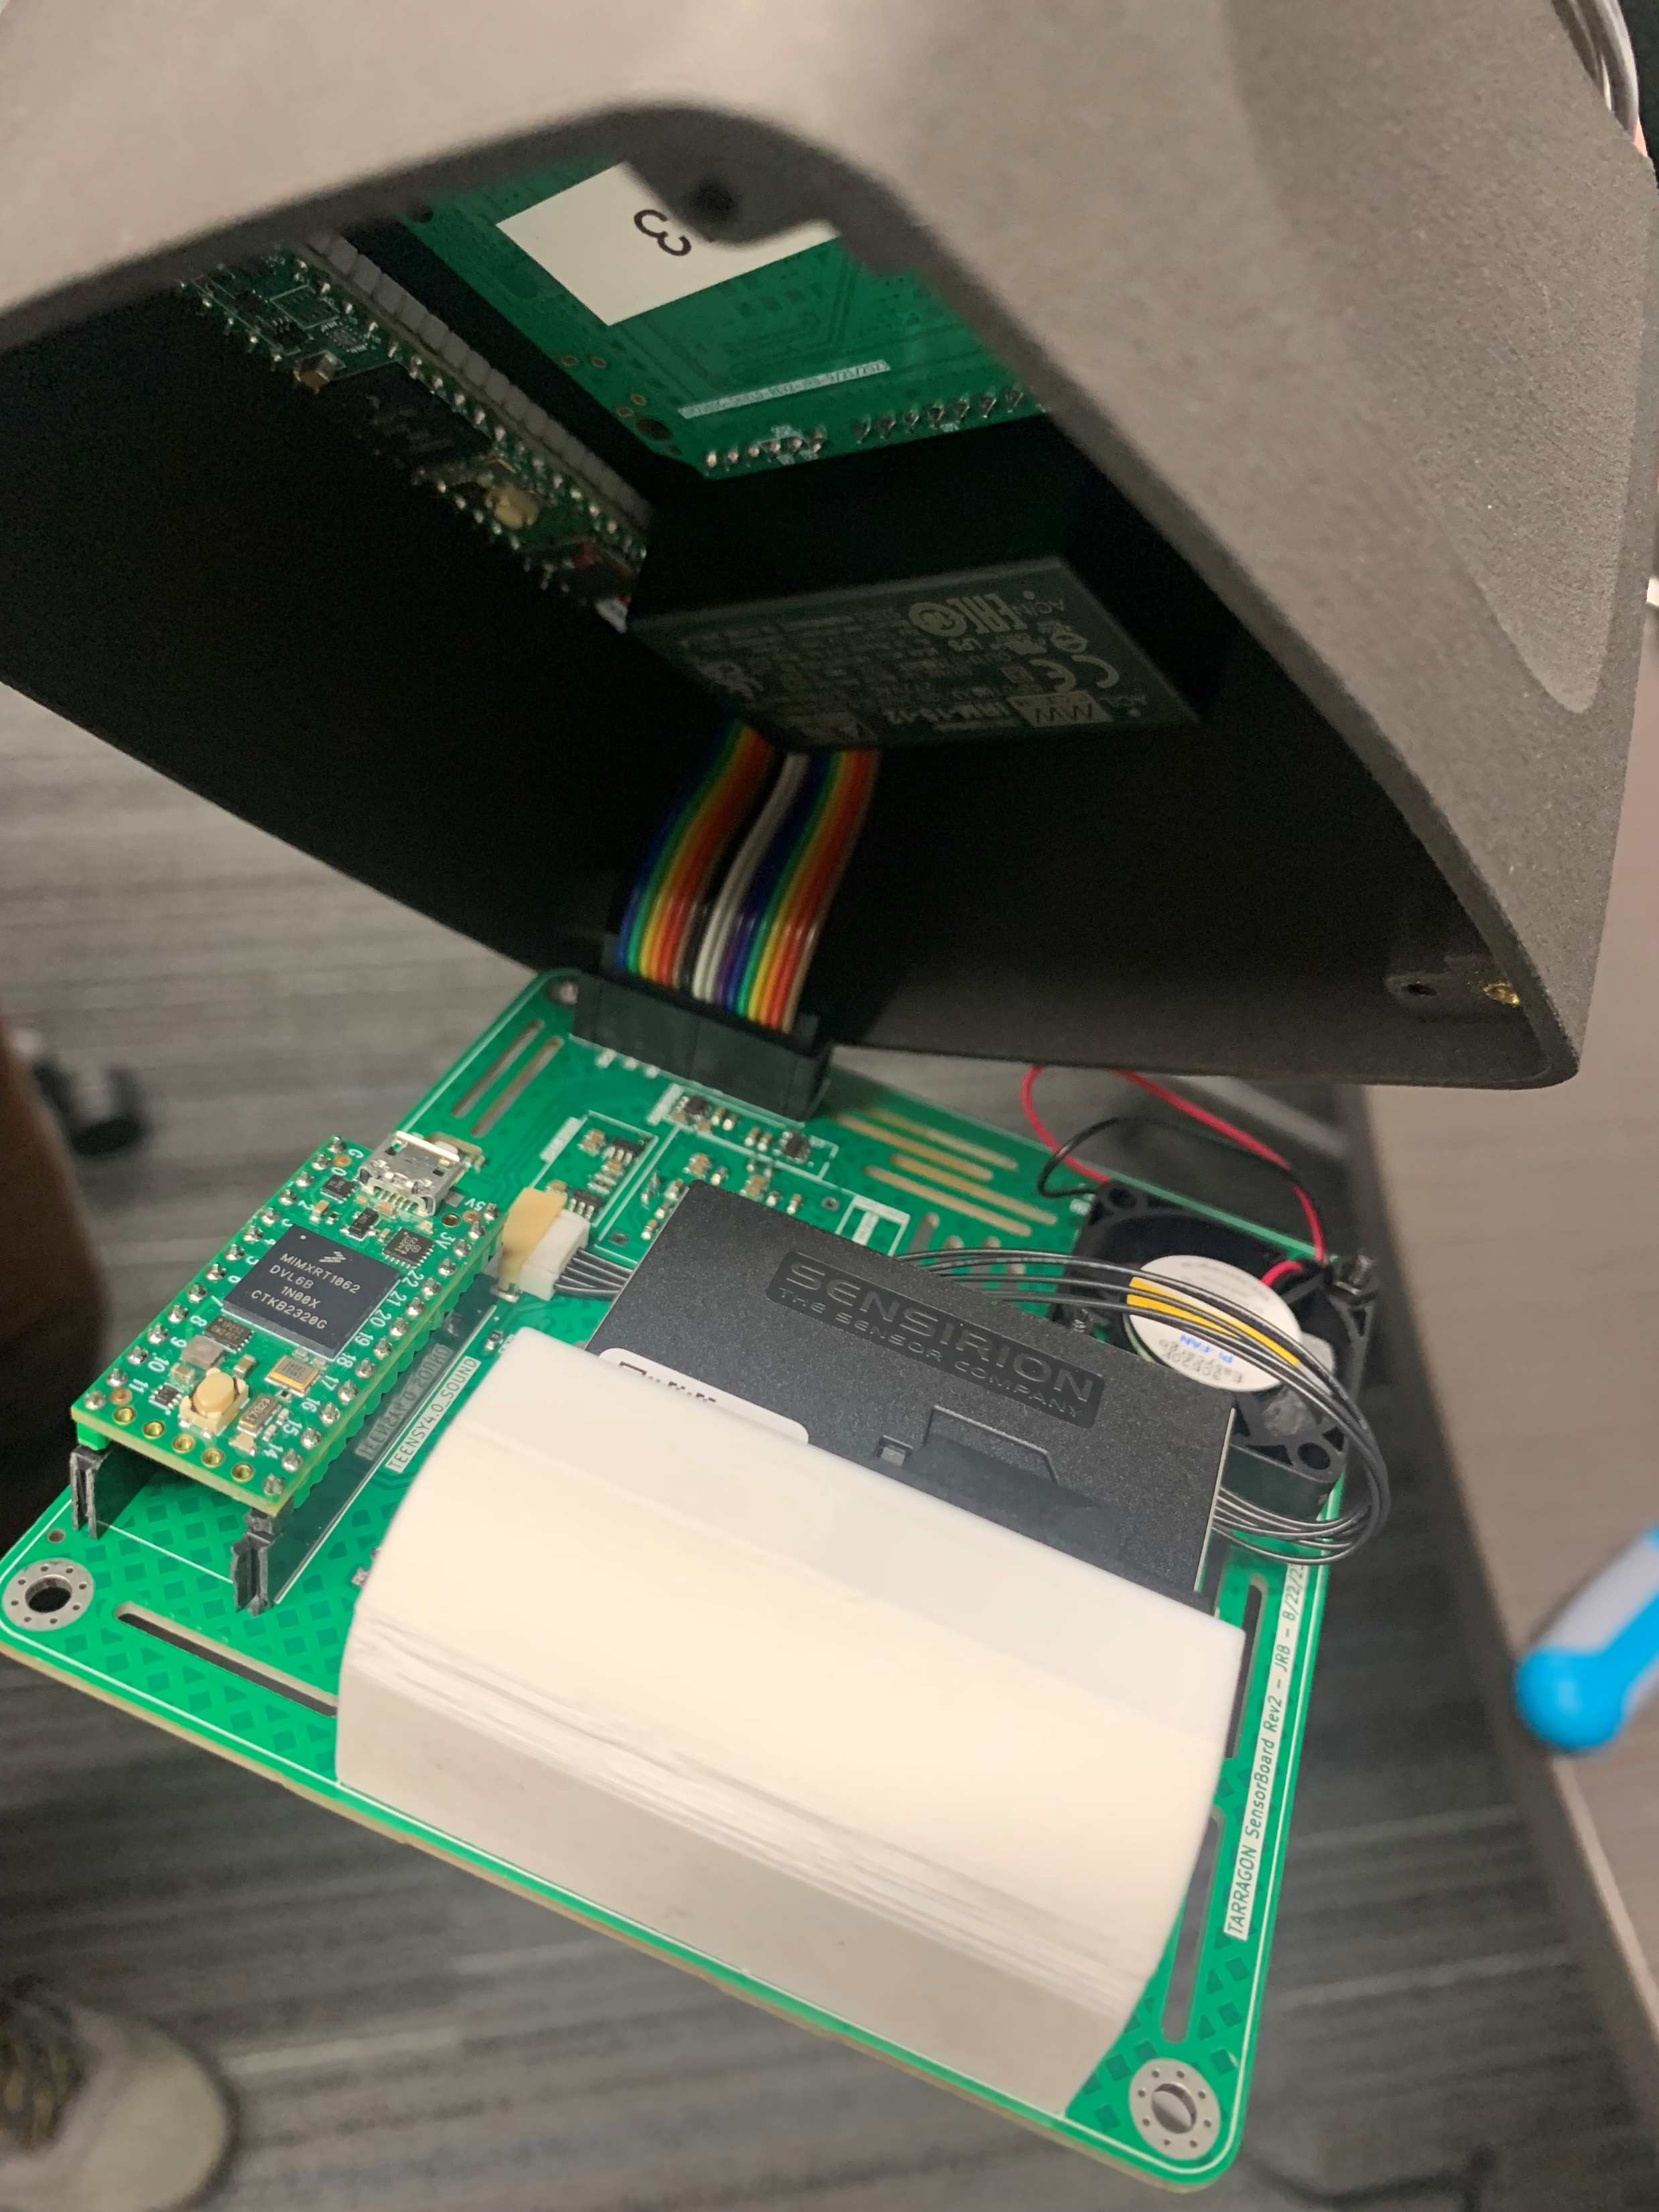
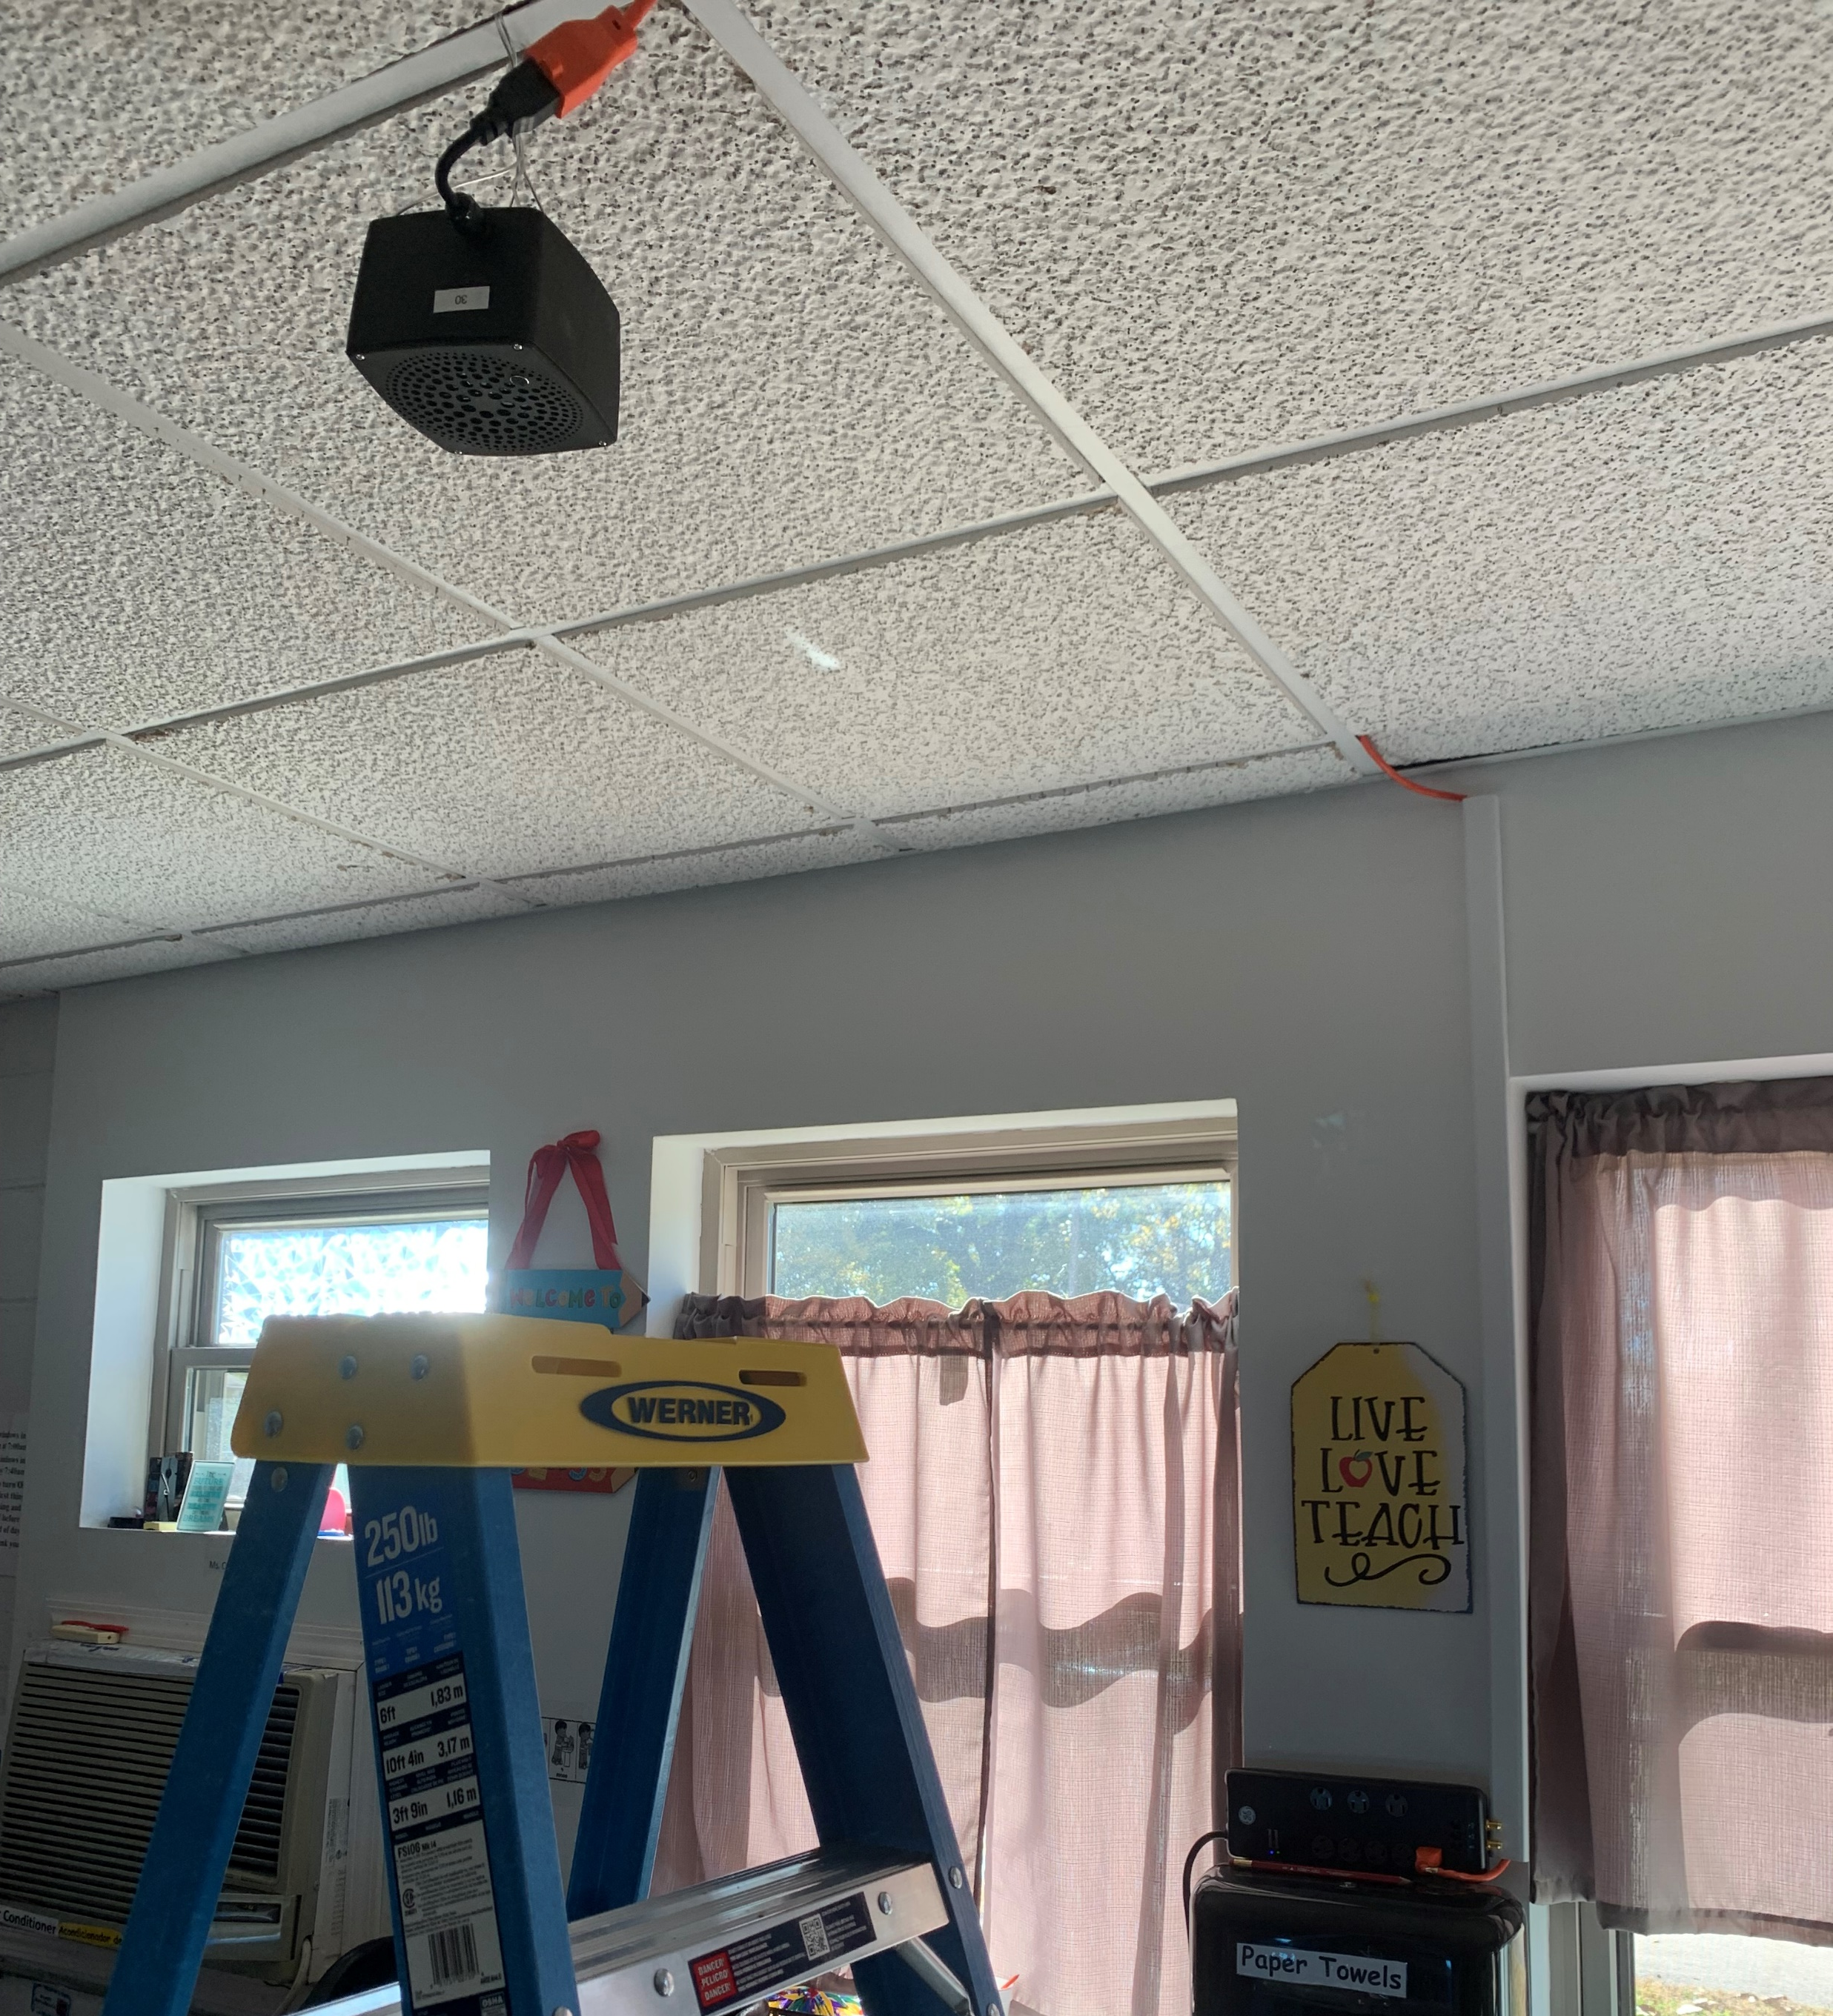
Low-cost Air Quality Monitors and their Installation
We installed AQ monitors in the 5 early education centers
The AQ monitor collects the following variables (8 measures per second):
  PM1, PM2.5, PM4, and PM10
  Total Volatile Organic Compounds (TVOCs)
  Nitrogen Oxides (NOx)
  Noise, Temperature, Humidity
Notes:
Smaller than a shoebox; about the size of a Kleenex box………………..has a small fan and makes almost no noise.

Slide 9
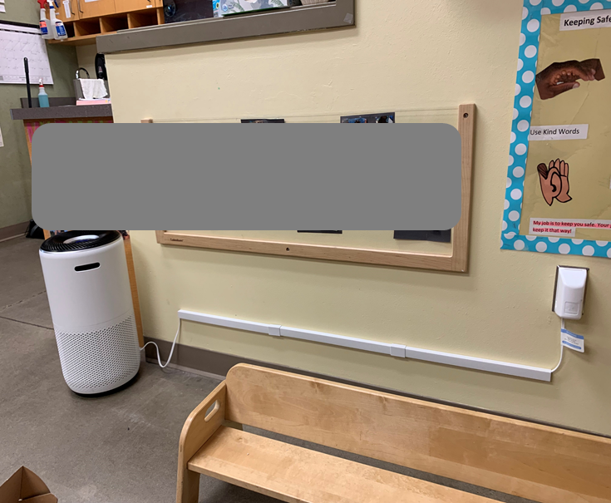
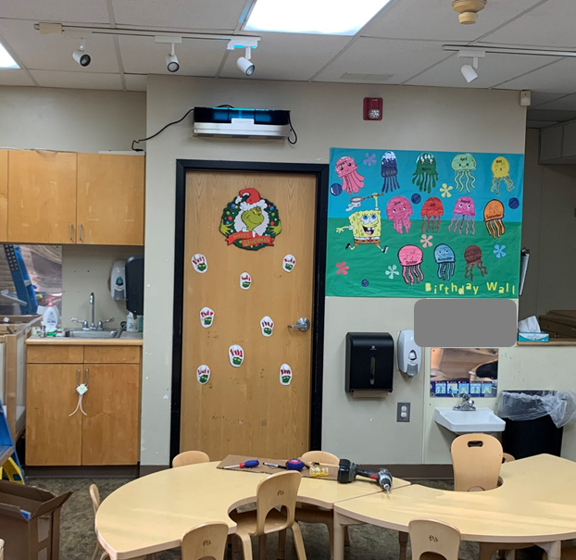
Intervention Devices and the Classroom Installations
Upper-Room Ultraviolet Germicidal Irradiation (UVGI) for Upper Air
Portable Air Purifier for Lower Air

Slide 10
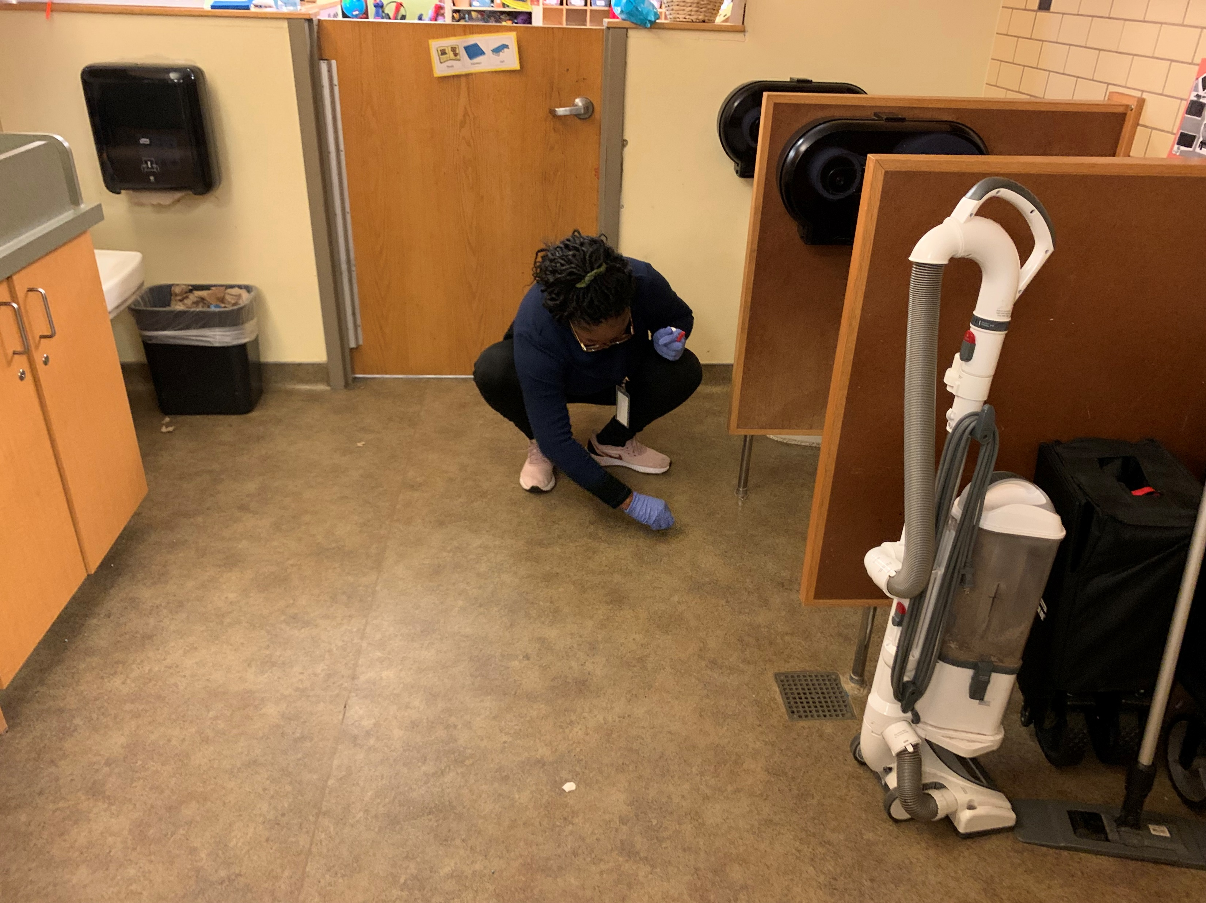
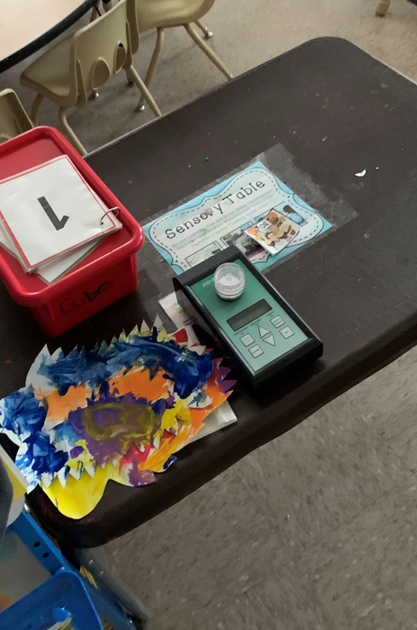
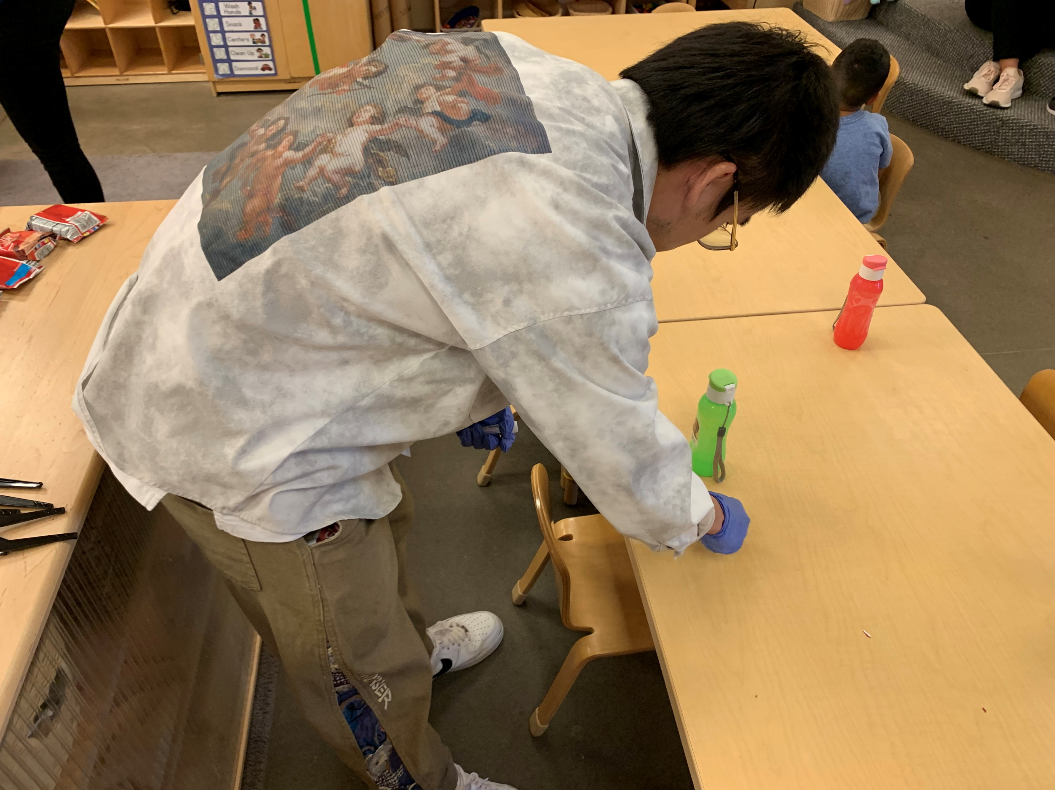
Field Baseline Sampling for Viral Analysis
Air Sampling
Surface Swab Sampling
We conducted the air and surface swab samplings in the 5 ECE centers (4 classrooms per center, ~250 samples in total)
  Air sampling when children are present
  Surface swab sampling on
    Children’ dining tables
    Floor around toilets
    Ventilation intake louvers
    Air filter in the purifier
Notes:
Air filter samples and swabs

Slide 11
OK-AIR: Data
Indoor air quality (IAQ) has been monitored since mid-November 2023 and interventions (air filtering, UV light scrubbing, both, neither) started the first week in December 2023.
  Currently getting the last of the summer season data.
Other data collected:
  Child and teacher absences
  Child social-emotional development (DECA)
  Parent/Family/Child Health Survey (self-report)
  Teacher Health Survey (self-report)
  Existing demographics and child health data already collected by HS/EHS
  Directors’ survey about building
  Focus group results from teachers
Teacher knowledge and attitude survey (more on this later; currently requesting your help)

Slide 12
OK-AIR: Results
Preliminary results – today will discuss:
  IAQ, virus, and child absence results
  focus group results related to feasibility of using equipment in Head Start/Early Head Start classrooms
  Teacher perceptions and knowledge about IAQ

Slide 13
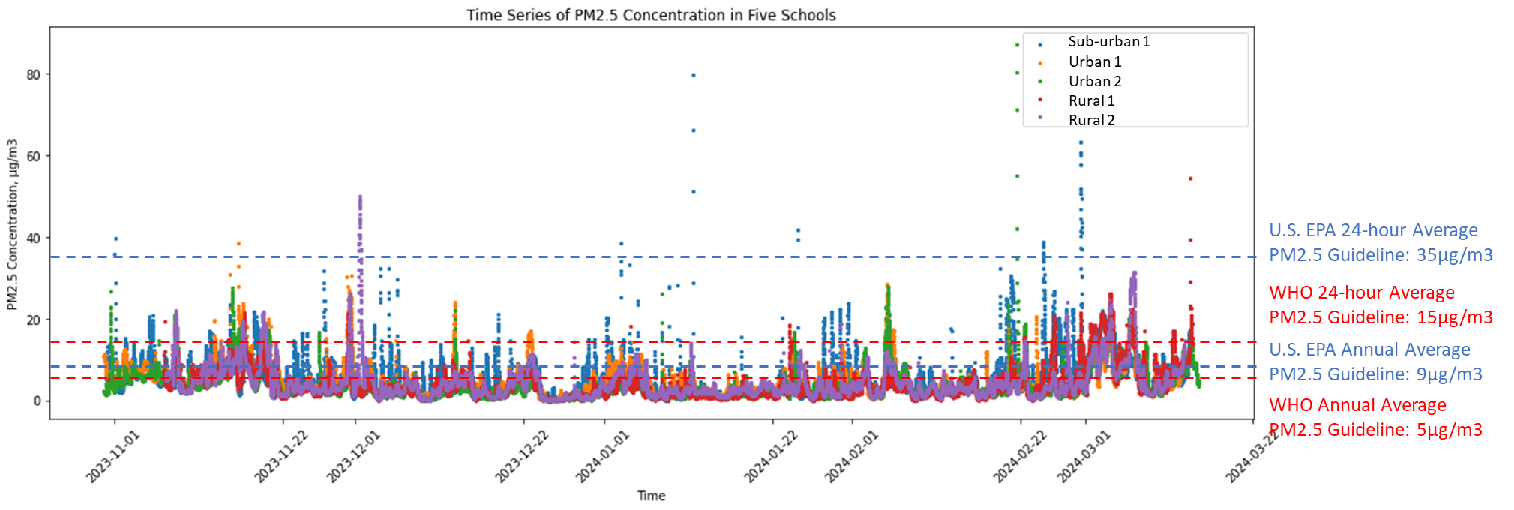
What is the IAQ in the Head Start Classrooms? (PM2.5 Time Series Plot in Five Schools / Winter as an example)
Baseline
Intervention
Baseline
Notes:
Results show PMs in air sometimes exceed recommended levels set by EPA and WHO.
Baseline periods are higher than intervention (both air filter and UV), higher than standards at baselines. Documents IAQ in these classrooms can be improved by our intervention.

Slide 14
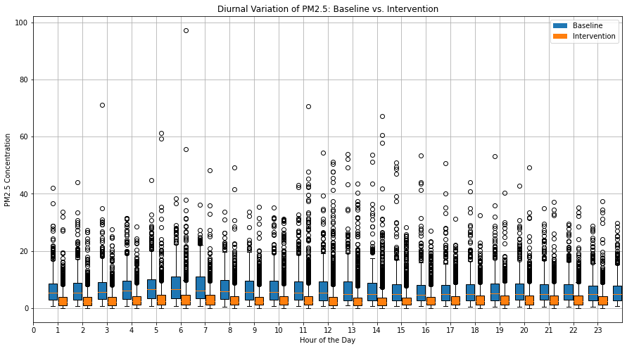
PM2.5 Concentration Reduction: Baseline vs. Intervention
Notes:
Both interventions vs control (baseline) for all classrooms

Slide 15
Statistical Analysis of PM
T-test | Sub-urban | Urban 1 | Urban 2 | Rural 1 | Rural 2 | Over all
t-statistic | 20.425 | 26.460 | 33.946 | 41.737 | 29.379 | 65.787
p-value | 0.0001 | 0.0001 | 0.0001 | 0.0001 | 0.0001 | 0.0001
Percentage Change | 35% | 46% | 61% | 62% | 56% | 51%
Notes:
Baseline vs intervention

Slide 16
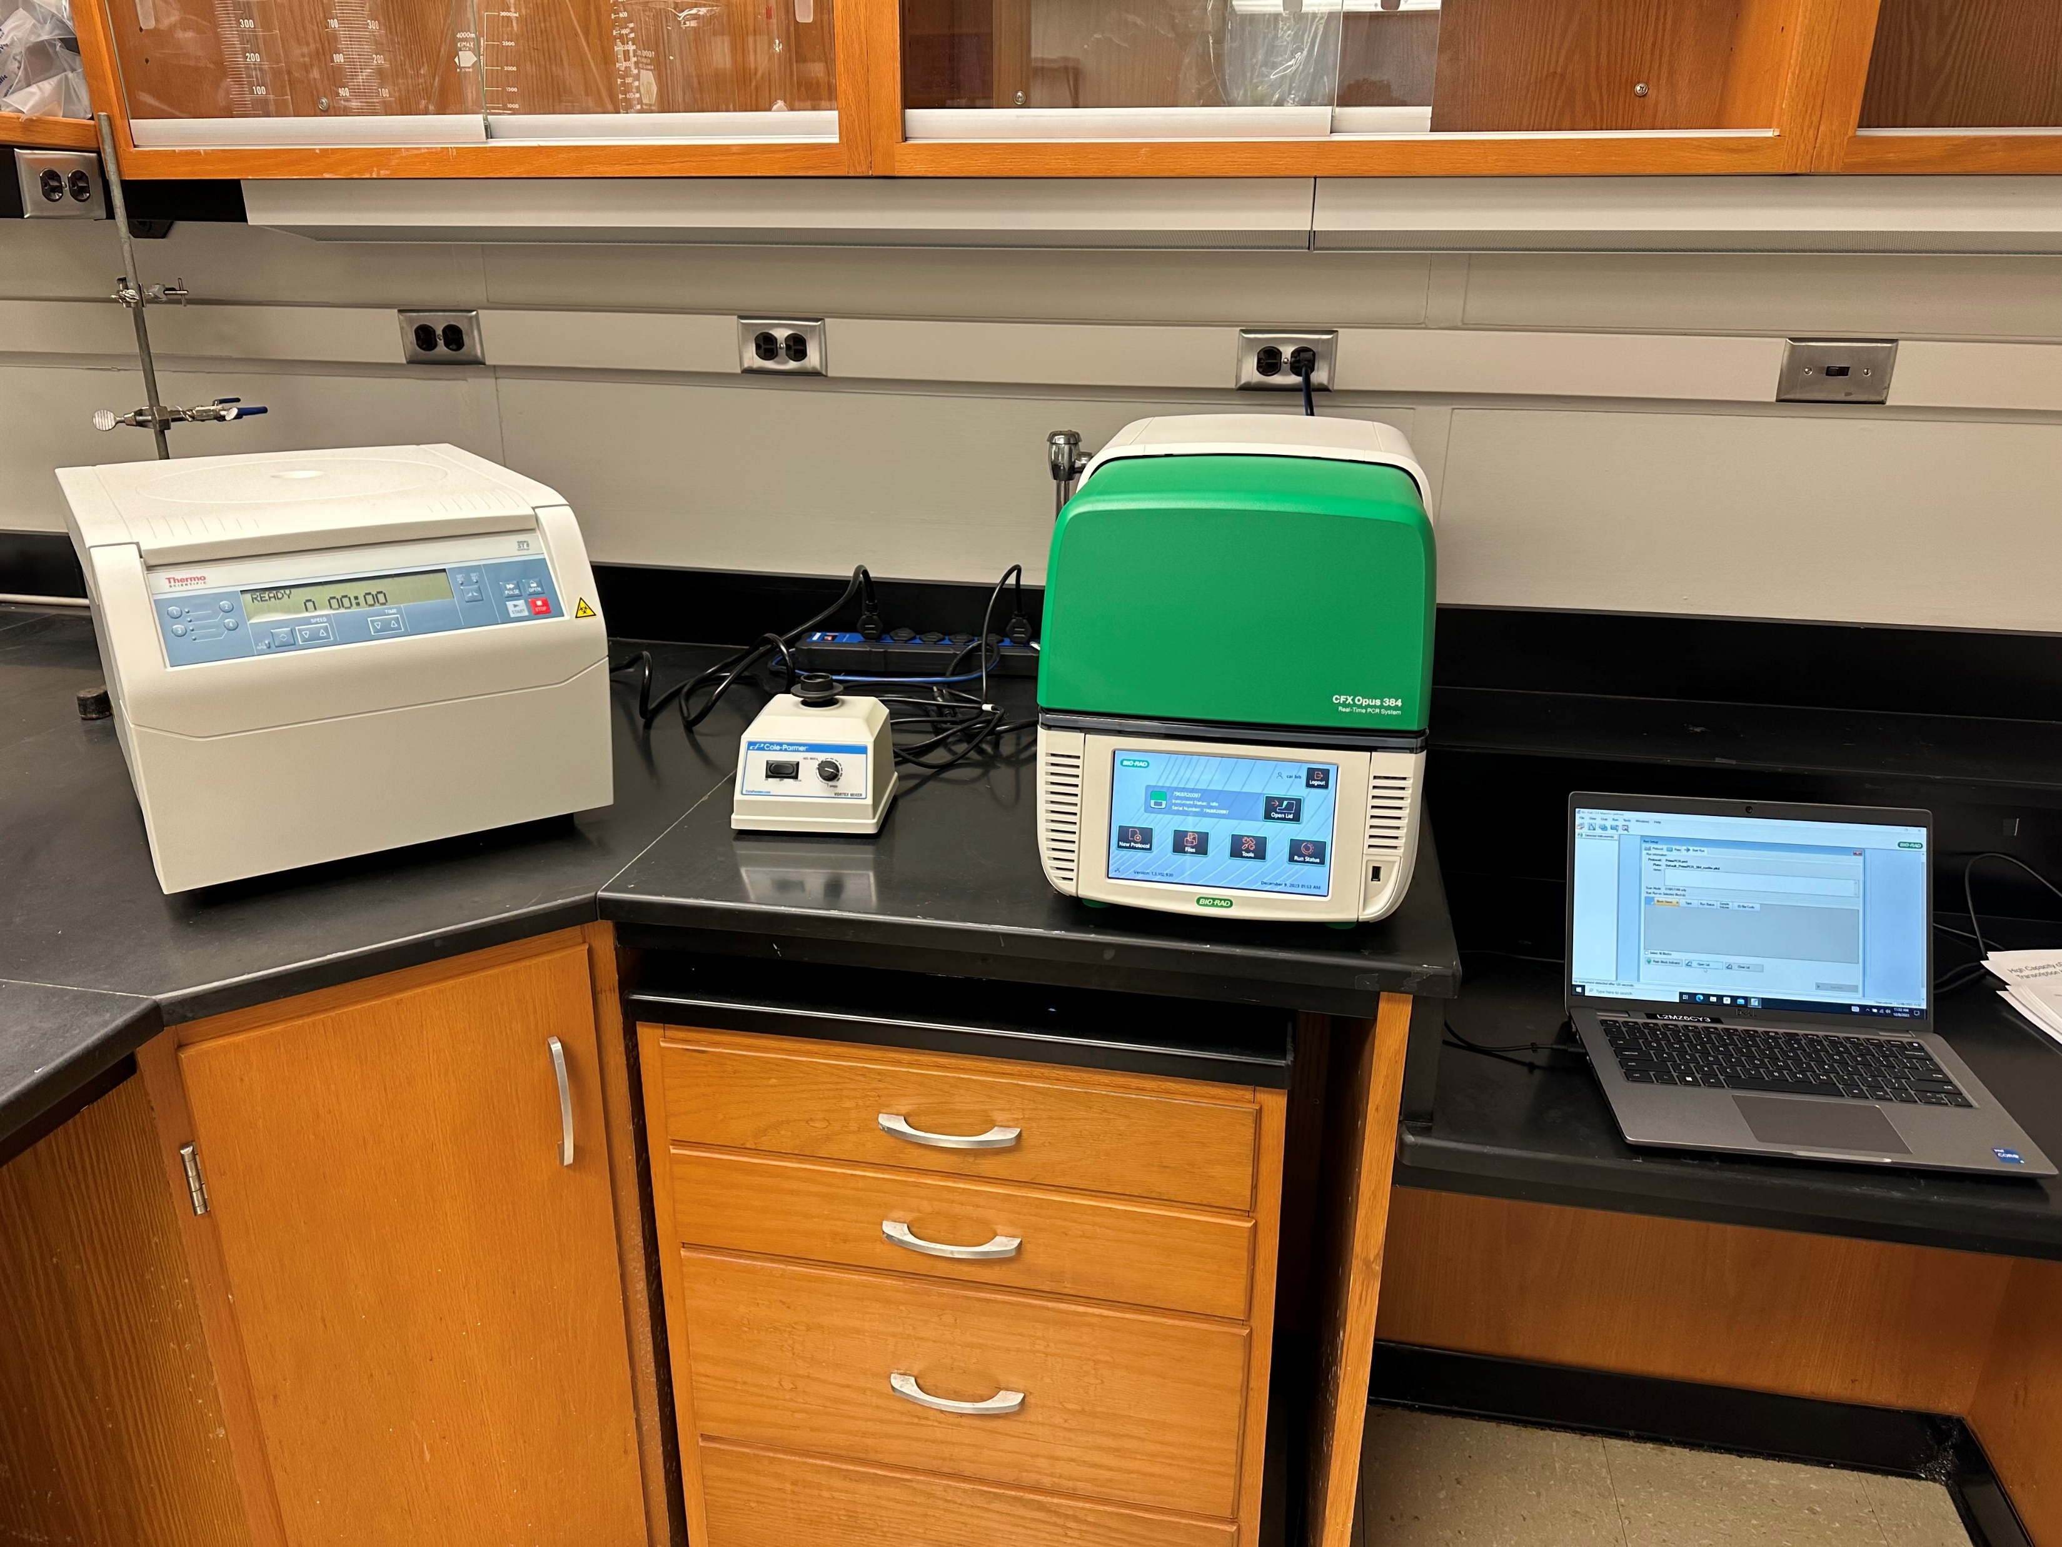
Laboratory Setup for Viral Analysis
We completed the qPCR (CFX Opus 384) setup in our Biosafety Level 2 (BSL) Laboratory.
  qPCR stands for quantitative polymerase chain reaction and is a technology used for measuring DNA/RNA using PCR

Slide 17
Viral Analysis of Swab Samples
(Collected on filters in air purifiers)
RT-qPCR results (copies/swab with standard deviation)
 | SARS-CoV-2 | Influenza A | Influenza B | Norovirus | RSV
Urban Center 1, room 1a | 273.68 +/- 20.00 | 288.42 +/- 119.42 | 218.15 +/- 61.17 | 57.39 +/- 17.00 | 29.03 +/- 11.82
Urban Center 1, room 1b | 455.24 +/- 178.57 | 12.66 +/- 20.20 | 166.44 +/- 156.27 | 95.12 +/- 67.00 | 45.68 +/- 24.41
Urban Center 1, room 3a | 254.44 +/- 95.20 | 279.30 +/- 145.49 | 8.20 +/- 12.00 | 3504.00 +/- 36.81 | 52.92 +/- 20.80
CC_S6* | - | - | - | - | -
Urban Center 1, room 3b | 48.27 +/- 36.74 | 233.65 +/- 97.66 | 28.23 +/- 47.17 | 1604.01 +/- 145.73 | 55.25 +/- 58.10
*CC_S6 was the "blank" swab; negative control
Notes:
All viruses detected in all classrooms on air filters; btw, swabs showed the same – all viruses detected on surfaces. Touch and breathing both ways to be exposed to viruses.

Slide 18
Sick-Related Child Absences
(PRELIMINARY N~80 children)
The “both” group has a high rate of children with chronic conditions, which might be the reason for their even higher absence rates compared to the “control” group.
Air purifier and UVGI reduced 11%-26% sick-related child absences.
Notes:
Preliminary analyses from 2 centers – urban. N is about 80 kids; around 20 kids per condition.
Need more participants to be certain of this result.

Slide 19
Conclusions
(for IAQ, virus, and child absence results)
Air purifiers significantly improved indoor air quality in ECE classrooms by reducing 51% of PM2.5.
All targeted viruses were detected in the air; and on surfaces including the dining tables, the toilet floors, and the ventilation intake louvers. Viruses included SARS-CoV-2, Influenza A, Influenza B, Parainfluenza virus 3, Norovirus, and Respiratory Syncytial Virus (RSV). Air purifiers collected the viruses.
Reduced sick-related absences were observed in air purifier (26%) and UVGI (11%) intervention groups (but need bigger sample to confirm child absence results).
Notes:
Did not have a large enough sample of teachers to analyze data with confidence.

Slide 20
Dissemination to Date: Conferences
American Industrial Hygiene Conference (AIHA CONNECT) 2024, May 20-22 in Columbus, Ohio
  Accepted abstract: Evaluating Interventions for Indoor Air Quality and Teachers’ Absenteeism in Winter: A Randomized Controlled Experiment in Early Childhood Education Centers
ACF’s National Research Conference on Early Childhood (NRCEC) in June in DC
  Accepted presentation: Indoor Air Quality--A Literature Review and RCT Study in Early Head Start/Head Start
Indoor Air 2024, July 7-11 in Honolulu
  Accepted abstract: Characterize and Intervene the Indoor Air Quality in Early Childhood Education Settings to Reduce the School Absenteeism Caused by Infectious Diseases
OK-AIR was featured in the OU VPRP’s 2023 Annual Report – see:
https://www.ou.edu/content/dam/research-norman/docs/pubs/Final-annual-report-2023-030624-web.pdf
Notes:
We also plan to present our findings to the participating programs, in OK at ECE meetings.
We also plan to submit papers for publications in both research- and practitioner-oriented journals.

Slide 21
Next Steps:
Secure funding for continuation of OK-AIR
  Recruiting ECE centers for additional air monitoring and study
Complete analyses
Share the results to impact practice and policy!
Notes:
Plan to publish in ECE as well as air quality journals; ECE journals that focus on practice and policy.

Slide 22
OK-AIR: Feasibility of ECE Classroom Use
Preliminary results :
  Focus group results related to feasibility of using equipment in Head Start/Early Head Start classrooms

Slide 23
Comments of OK-AIR participating teachers
In the Focus Groups, teachers said that –
They appreciated the project for increasing general awareness about clean air in classrooms
The OK-AIR project heightened their own awareness of the importance of clean air, especially in polluted environments​
Many teachers observed that classrooms with filtration equipment experienced fewer illnesses, though this wasn’t universally reported
Some reported the equipment made noise; and that impacted neurodivergent children
Teachers found the OK-AIR project to be a productive and worthwhile experience
They appreciated the incentives

Slide 24
OK-AIR: Teacher Perceptions and Knowledge
Preliminary results
  based on limited number of participants
  Seeking more participants

Slide 25
Teacher Knowledge of IAQ
Notes:
Only 33% of teachers rated their IAQ knowledge as "Good" or "Very Good”;
38% reported their knowledge was poor or very poor;
29% said moderate level of knowledge

Slide 26
Teachers' Report of Formal Training on IAQ
Notes:
65% had no formal training on the subject

Slide 27
Teachers’ Perception of IAQ's Impact on Children
Notes:
52% of respondents felt that IAQ negatively affects children's learning and development to a large or very large extent​
85 % reported moderate, large or very large impacts

Slide 28
How often do teaching staff think about IAQ?
Notes:
Almost ½ (45%) report they think about IAQ never or rarely; 38% said sometimes.
So, this could mean they see this concern as outside or beyond their duties…………………implication for administrators?

Slide 29
The 5 Most Important IAQ Features in Classrooms
(as reported by teachers)
  • 86% of respondents reported never experiencing cigarette smell in their classrooms.
  • 33% of respondents sometimes experience humid air, with 19% reporting concerns.
  • 38% of respondents reported classrooms are too warm, while 14% reported them being too cold.
  • 33% reported a noticeable smell of cleaning supplies, with 14% indicating it as a significant concern.
  • 38% reported stuffy or stagnant air, with 10% indicating it as a significant issue.

Slide 30
Classroom Conditions that Teachers Control
Notes:
Only 26% of teachers reported having the ability to open windows, and just 5% had air purifiers

Slide 31
Symptoms Reported by Teachers
A significant number of teachers reported experiencing _____ inside their classroom due to poor IAQ:
  Headaches (57%),
  Stuffy nose (38%),
  Tiredness (52%)

Slide 32
Next Steps for OK-AIR:
Secure funding for continuation of OK-AIR
  Recruiting ECE centers for additional air monitoring and study
Complete analyses
  Especially interested in absences of children and teachers
  Curious about potential social-emotional impacts on children
Collect more data about teachers’ knowledge and perceptions
Request: Please have your staff complete our teacher survey about IAQ………….have flyers

Slide 33


Slide 34



Children’s Environmental Health Center in U.S. Southern Great Plains
Changjie Cai¹, Diane Horm², Dan Li³
Hongwan Li¹, Matthew Lemberger-Truelove⁴, Anni Yang⁵, Wenwen Cheng⁶
¹Department of Occupational and Environmental Health, Hudson College of Public Health, The University of Oklahoma – Health Sciences
²Early Childhood Education Institute, The University of Oklahoma – Tulsa
³Department of Health Promotion Sciences, Hudson College of Public Health, The University of Oklahoma – Health Sciences
⁴Department of Counseling and Higher Education, College of Education, University of North Texas
⁵Department of Geography and Environmental Sustainability, College of Atmospheric and Geographic Sciences, The University of Oklahoma – Norman
⁶Department of Planning and Landscape Architecture, College of Letters & Science, University of Wisconsin-Madison
Notes:
Looking for programs in Jan 2025 to work with us………..

Slide 35

DISCUSSION and QUESTIONS
THANK YOU
(Thanks to OPSR for Year #1 funding)
Diane Horm (dhorm@ou.edu)
Changjie Cai (changjie-cai@ouhsc.edu)
Barbara Fuhrman (barbara.fuhrman@gmail.com)

