Slide 1


The State of Suspension and Expulsion in Oklahoma: A Comprehensive Mixed-Methods Investigation
Our OU Team:
Courtney Beers Dewhirst; Brittany Hott; Tim Ford; Kyong Ah Kwon; Kate Gallagher
Graduate Students:
Bre Martin; Kokab Khalilipaji; Savannah Gandy, Julie Attwood; Sarah Heiniger

Slide 2
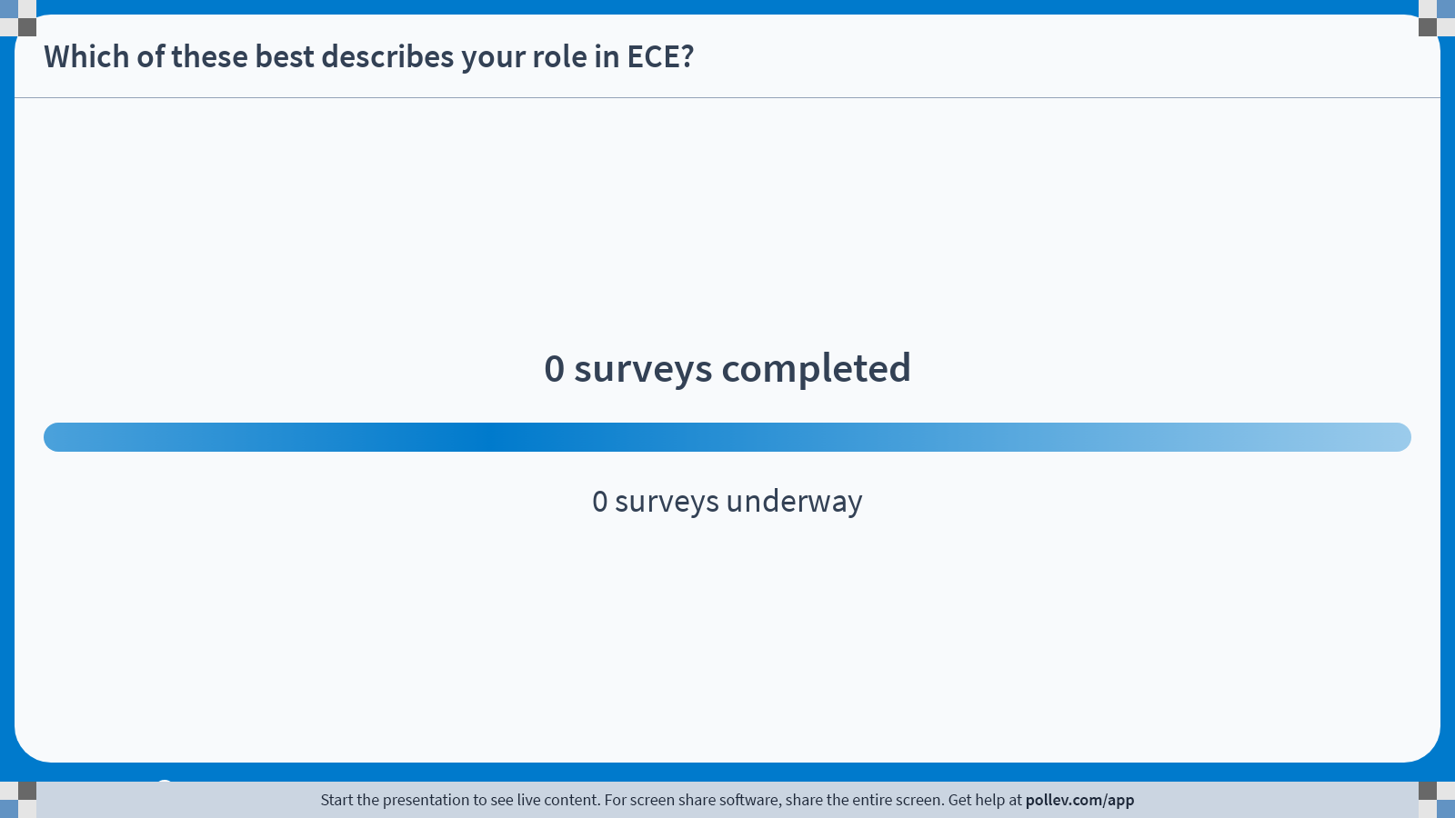
Notes:
Do not modify the notes in this section to avoid tampering with the Poll Everywhere activity.
More info at polleverywhere.com/support
Which of these best describes your role in ECE?
https://www.polleverywhere.com/surveys/upzNpkCfkN1gg1NCQsmYt?display_state=chart&activity_state=opened&state=opened&flow=Engagement&onscreen=persist

Slide 3
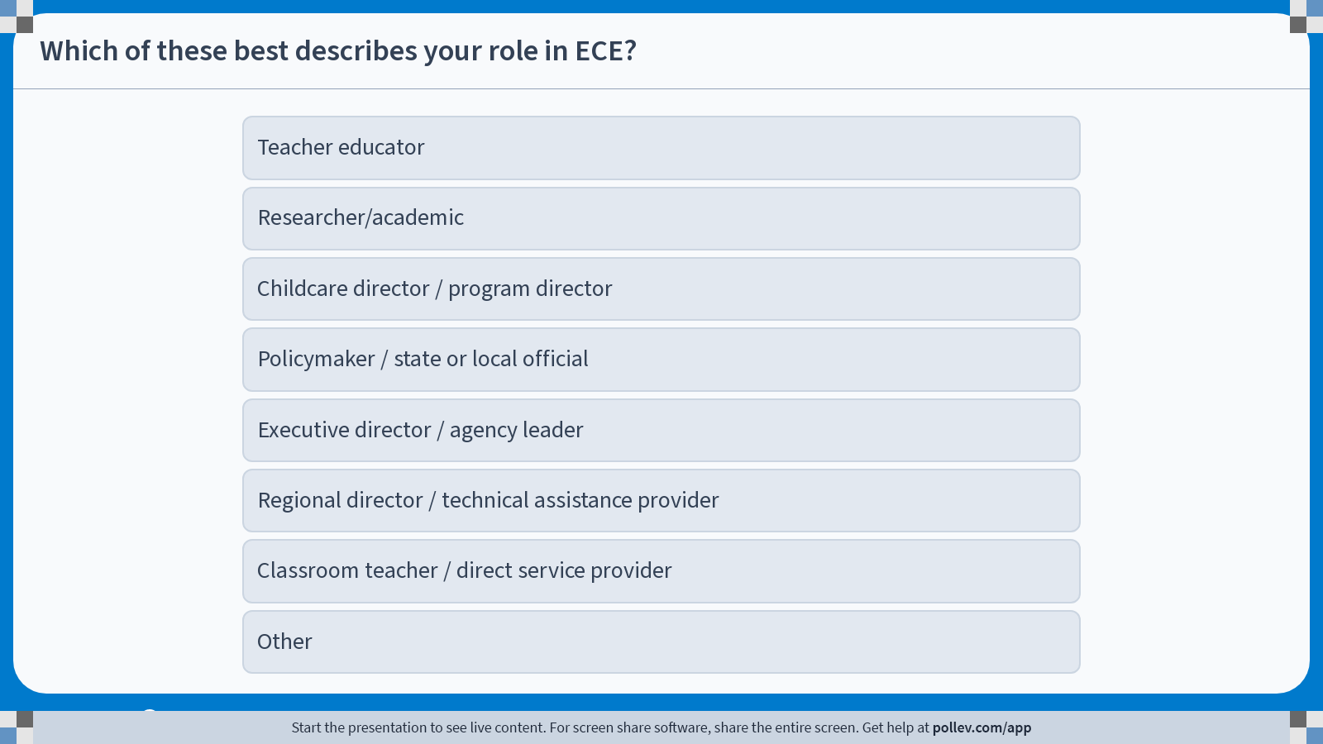
Notes:
Do not modify the notes in this section to avoid tampering with the Poll Everywhere activity.
More info at polleverywhere.com/support
Which of these best describes your role in ECE?
https://www.polleverywhere.com/multiple_choice_polls/DqnFGhTMemEiDvIDYDp8Q?display_state=chart&activity_state=opened&state=opened&flow=Engagement&onscreen=persist&hide=instructions

Slide 4
The Scope of ECE Exclusionary Discipline
Literature Review Background
Annual Impact
Critical Statistics
50,000
Preschoolers expelled at
Preschoolers suspended annually in the United States
3X
17,000
the rate of K-12 students
Preschoolers expelled from educational settings
Program Prevalence (2024)
61.4% suspended at least one child
37.8% expelled at least one child
Only 33% engaged in neither
250 children
removed from settings daily nationwide
Financial Impact: $2.7 billion lifetime cost

Slide 5
Disparities and Long-Term Impacts
Who is most affected and why it matters
Disproportionate Impact by Demographics
Race & Ethnicity
Disability Status
Intersectional
Black: 3.6X higher rates
With disabilities:
Low-income girls: Harsher discipline
18% enrollment, 42% suspensions
14.5X more likely expelled
Hispanic: 3.7X higher
3.6X higher suspensions
Black girls: 48% multiple suspensions
Native American: 4-5X higher
Autistic: 1 in 6 expelled
High-poverty: 20% less prevention
Long-Term Consequences
Educational Impact
Neurological Development
Family Impact
10X more likely to drop out
Unpredictability harms:
Job loss/disruption
Financial hardship
Emotional distress
Care challenges
Disrupted learning trajectories
Neural circuits
Inhibitory control
Self-regulation
Reduced achievement
Critical: Expelled children face increased risks of future incarceration and criminal victimization

Slide 6
Project Timeline 2025
ECE Expulsion & Suspension Research Study
Q1: Jan-Mar
Q2: Apr-Jun
Q3: Jul-Sep
Q4: Oct-Dec
January
April-June
Jul-Aug
October
IRB Approval
Admin Survey Distribution
Teacher Survey (cont.)
Complete Best Evidence Synthesis
Feb-March
Focus Groups Begin
Best Evidence Synthesis (cont.)
Complete Focus Groups
Survey & Protocol Creation
June Start
Best Evidence Synthesis Begins
Complete Analysis
September
Teacher Survey Launch
Parent Survey
Nov-Dec
Data Analysis Begins
Dissemination
Best Evidence Synthesis (cont.)
Final Report
Data Collection & Analysis Summary
Survey Timeline:
Qualitative & Synthesis:
Key Deliverables:
Quantitative data from 3 surveys
Best evidence synthesis report
Qualitative data from focus groups
Final comprehensive report
Administrators: April-June
Teachers: June-August
Parents: September
Focus Groups: July-October (Administrators, Teachers, Parents)
Best Evidence Synthesis: June-October

Slide 7
What Did We Want to Know?
Research Questions Guiding Our Oklahoma ECE Study
Current State & Patterns
What are the current rates and patterns of preschool suspension/expulsion in Oklahoma?
How do expulsion rates vary across different demographics and settings in Oklahoma?
Contributing Factors & Context
What are the contexts (e.g., predictive factors) surrounding suspension/expulsion in Oklahoma?
In what conditions are expulsion and suspension used or considered for use in Oklahoma?
What factors contribute to expulsion decisions in Oklahoma?
What multi-level factors influence the use of exclusionary discipline in Oklahoma ECE settings, and how do these factors interact?
Stakeholder Perspectives & Resources
How do stakeholders (administrators, teachers, parents) differentially experience and perceive exclusionary discipline practices?
What is the current landscape of prevention and intervention in Oklahoma ECE, and what gaps exist between needs and resources?

Slide 8
Survey Instruments
Data Collection Tools for Multi-Stakeholder Perspectives
Administrator Survey
Program Characteristics
Behavior Management
Exclusions (12 months)
Zip code, QRIS scores
Program type, ratios
Suspension/expulsion policies
Resources available; assets
SEL frameworks used
IECMHC/Pyramid Model
Discipline methods
Number suspended
Voluntary removals
Expulsion demographics
Child Demographics
Age, race/ethnicity, gender
Special needs, ELL
Trauma/behavioral concerns
IFSP/IEP status
Standardized Measures
Colorado Early Care and Learning Resource (Miles et al., 2021)

Slide 9
Survey Instruments
Data Collection Tools for Multi-Stakeholder Perspectives
Teacher Survey
Parent Survey
Teacher Demographics
Child Information
School Resources
Education, years teaching
Classroom age group
Special needs/disabilities
Suspension/expulsion history
Type of ECE setting
Disciplinary actions experienced
Child supports provided
Family supports offered
Professional referrals
Policy awareness
Program Info
Zip code, program type
Classroom ratios
Resources; assets
Suspension/Expulsion Details
Demographics
Reasons for exclusion
Frequency of incidents
Time to find new placement
Parent demographics
Focus group barriers
Exclusions (12 months)
Number suspended/expelled
Child demographics
Special needs, ELL, IEP
Impact & Support
Changes in work/financial
Mental health/stress impact
Support services sought
School resources received
Standardized Measures
Job Stress Inventory
PERM - Risk factors:
Classroom disruption
Fear of accountability
Teacher stress
Hopelessness

Slide 10
Preliminary Focus Group Findings
10 Administrators 19 Teachers 19 Parents
Intersecting Factors Identified
System-Level Challenges
Child-Level Factors
Staffing Crisis
Developmental delays and sensory processing issues
Diagnosed/undiagnosed conditions (autism, ADHD)
Emotional dysregulation challenges
Teacher burnout & turnover
Service Gaps
Mental health & therapeutic services leaving
Family Factors
Resource Scarcity
Home instability and inconsistent parenting
Technology dependence (new contemporary factor)
Parent stress and unavailability
Funding constraints limit implementation
Training Gaps
Especially for practical behavior management
Environmental Triggers
Interaction Effects
Transitions and unstructured time
Peer interactions and conflicts
Time of day effects
Home-school disconnect
Communication breakdowns
Limited collaboration time
Key Finding: COVID-19 created a distinct cohort with unique developmental and behavioral challenges
"Exclusionary discipline often results from system failures rather than child behaviors alone"

Slide 11
Stakeholder Perspectives
Distinct Viewpoints and Shared Concerns
Administrators (n=10)
Teachers (n=19)
Parents (n=19)
Emphasize:
Highlight:
Report:
Need for comprehensive support systems
Importance of prevention & early intervention
Challenges with policy implementation
Emotional toll & need for breaks
Lack of preparation for behaviors
Disconnect between decision-makers & classroom reality
Feeling blamed or excluded from solutions
Need for peer support & advocacy
Trust-building essential for collaboration
Daily Struggles:
Managing multiple challenging behaviors simultaneously
Protecting other children while supporting struggling ones
Time constraints limit individualized approaches
Key Concerns:
Experience:
Staffing crisis impacts everything
Balancing individual needs with program safety
Resource allocation decisions
Sudden notifications without warning signs
Limited options after exclusion
Financial & emotional family impact
"We need system-level solutions, not band-aids"
"We're expected to be therapists without the training or support"
"We want to be partners, not problems"
Universal Agreement Across All Groups
Prevention is prioritized over exclusion — but all lack resources to implement effectively
Success stories emphasize: Relationships • Consistency • Individualized approaches

Slide 12
Current Practice Strengths & Critical Gaps
What's Being Used vs. What's Needed
Current Interventions Reported
Evidence-Based Programs
Environmental Modifications
Pyramid Model implementation
Positive behavior support systems
Evidence-based curricula
Calming spaces & sensory tools
Visual schedules & supports
Structured routines
Support Strategies
Individual support & co-regulation
Parent education & collaboration
Mental health consultation (when available)
Available Resources
Child Care Resource & Referral (CCR&R)
Tribal partnerships (multiple tribes)
Evidence-Practice Gap
Paradox: Everyone agrees on what's needed—prevention, support, collaboration—but we lack both the resources to implement AND the evidence that they work
University collaborations
Other
Programs are using interventions that seem logical but lack rigorous evidence of effectiveness in preventing exclusion

Slide 13
Current Practice Strengths & Critical Gaps
What's Being Used vs. What's Needed
Critical Gaps Identified
Mental Health Services
Increasingly scarce and difficult to access
Specialized Expertise
Limited for complex behavioral needs
Trauma-Informed Training
Insufficient preparation for trauma responses
SEL Assessment Tools
Lacking appropriate evaluation measures
Evidence-Practice Gap
Parent Preparation
Education gaps in behavior support
Programs are using interventions that seem logical but lack rigorous evidence of effectiveness in preventing exclusion
Infant/Toddler Interventions
Age-appropriate strategies needed

Slide 14
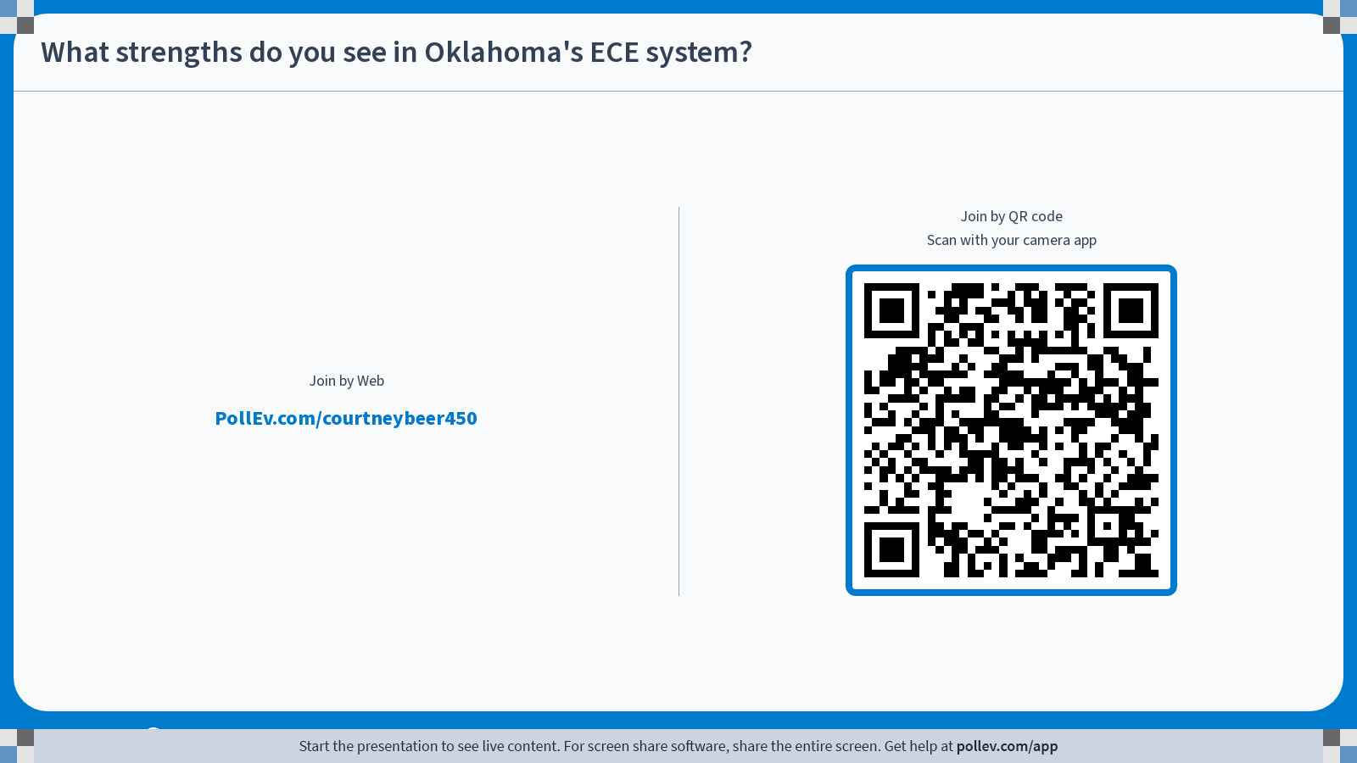
Notes:
Do not modify the notes in this section to avoid tampering with the Poll Everywhere activity.
More info at polleverywhere.com/support
What strengths do you see in Oklahoma's ECE system?
https://www.polleverywhere.com/free_text_polls/SNBuOCn2dmYmMj2f08rlx?display_state=chart&activity_state=opened&state=opened&flow=Engagement&onscreen=persist&hide=instructions

Slide 15
The Need for Inclusive Practices in ECE Settings
Inclusive Practices
Providing all students, regardless of ability, disability, or other factors, with access to: (Love & Horn, 2021)
A wide variety of learning opportunities
Individualized modifications that facilitate participation with peers
Systems-level supports that undergird classroom efforts
Need for common criteria to define inclusive practices in research (Dell’Anna et al., 2021)
Outcomes of Inclusive Practices (Dell’Anna et al., 2021; Kefallinou et al., 2020)
Improved social skills, communication, cognitive development, and post-school outcomes
Development of greater tolerance, empathy, understanding of diversity, and improved social problem-solving skills
Barriers to Implementation (Agran et al., 2020)
Bias
Teacher preparation and experience
Lack of resources and capacity
Knowledge of current research

Slide 16
The Need for Inclusive Practices in ECE Settings
Align Resources
Inclusive Practices
How can schools align resources to facilitate effective inclusive practices?
Understanding Community Goals and Needs
Strengths-Based Collaboration
Focus on ability
Ongoing communication
Effective Dissemination Practices
Considerations for Oklahoma students, educators, and families
Funding
Professional development
ECE infrastructure

Slide 17
Community Needs: Effective Evidence-Based Practices
Bridging the Gap Between Research and Practice
Evidence-Based Practices
Community-Identified Priorities
Rural Implementation Challenges and Solutions
What are widely accepted EBPs in ECE?
Priorities
Fidelity of Implementation
Students
Educators
Families
Administrators
Social Validity
Translation of EBPs
Sustained Implementation
For whom, under what conditions
Ongoing, High-Quality PD
Challenges
Moving beyond one-time PD to inclusive coaching models
Turn-over
Training
Resources
Adopting EBPs in Practice
Supportive Organizational Culture
Educator training
Perceptions
Time and resources
Community/University partnerships

Slide 18
Advancing Research: Single Case Designs & Rigorous Methods
Moving Beyond Correlation to Establish Causation
Single Case Design
Participant performance is measured during a baseline condition and compared to an intervention condition (Ledford et al., 2017)
Three clear demonstrations of behavior change at three distinct points in time – functional relation (Barton et al., 2019).
Baseline Logic:
  Prediction
  Affirming the consequence
  Verification
  Manipulation of the IV
Core Features: (Hott et al., 2021)
Behavior is operationally defined
Behavior is measured via direct observation repeatedly across time
Behavior is observed to identify if changes occur when and only when intervention is introduced
Behavior is measured by more than one observer
Implementation of the intervention is measured

Slide 19
Advancing Research: Single Case Designs & Rigorous Methods
Moving Beyond Correlation to Establish Causation
Single Case Design
Methodologies (Hott et al., 2021)
Withdrawal
Changing Criterion
Multiple Baseline
Alternating Treatments
Multicomponent
Application
Small n intervention studies
  Withdrawal
  Changing Criterion
  Multiple Baseline
  Alternating Treatments
  Multicomponent

Slide 20
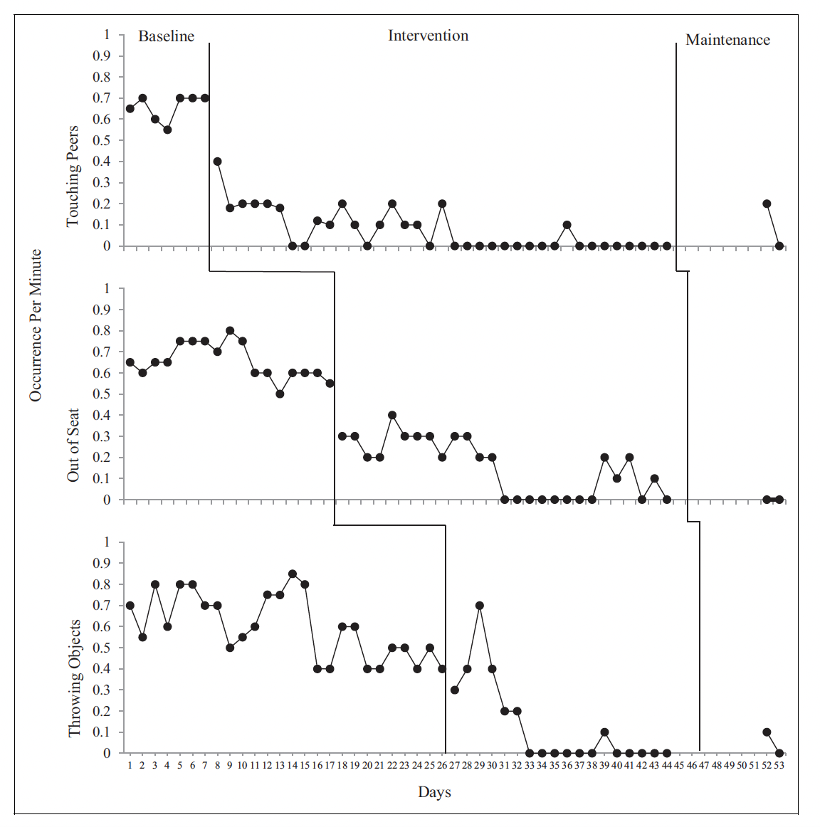
Advancing Research: Single Case Designs & Rigorous Methods
Moving Beyond Correlation to Establish Causation
Group Designs
Compare the outcomes between a treatment group and a control group (Hott et al., 2025)
Students
Teachers
Schools
Districts
Common Group Designs (Hott et al., 2021; Hott et al., 2025)
Randomized Control Trials (RCTs)
Quasi-Experimental Designs
  Regression Discontinuity Design (RDD)
  Switching Replication Design (SRD)
  Propensity Score Matching
  Fixed-Effect Regression Design
Power analysis
Application
Causal effectiveness or efficacy of an intervention

Slide 21
Advancing Research: Single Case Designs & Rigorous Methods
Moving Beyond Correlation to Establish Causation
Advantages of ECE Intervention Research
What are some advantages to conducting ECE intervention research?
Addressing the Evidence Gap
The scope of the identified problem
Diverse locales (i.e., rural, suburban, urban)
Diverse population
Practical Considerations for Oklahoma ECE Settings
Poverty rates (OPI, 2023)
Child care deserts (CAP, 2024)
High ACE scores (Beaman et al., 2023)
Geographic barriers to resources (Cooper et al., 2018)

Slide 22
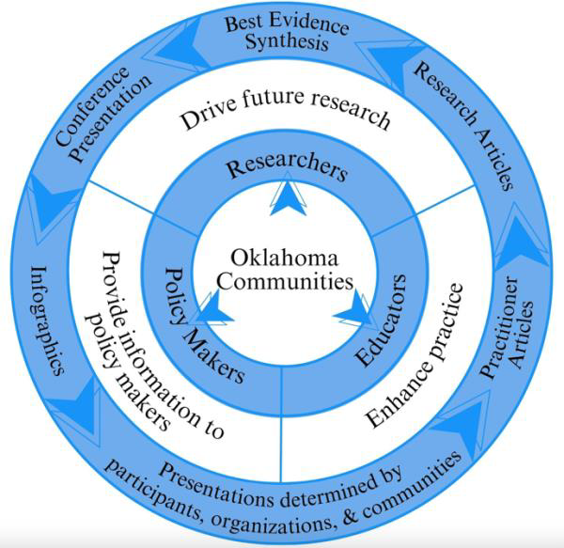
Dissemination & Continued Research
Building a Sustainable Knowledge-to-Practice Pipeline
Next Steps:
Provide information to community
Enhance practice through training
Continued stakeholder engagement
Iterative research refinement
Researchers
Educators
Drive Future Research
Our Commitment: Research WITH communities, not ON communities—ensuring findings translate to meaningful change in Oklahoma ECE settings

Slide 23
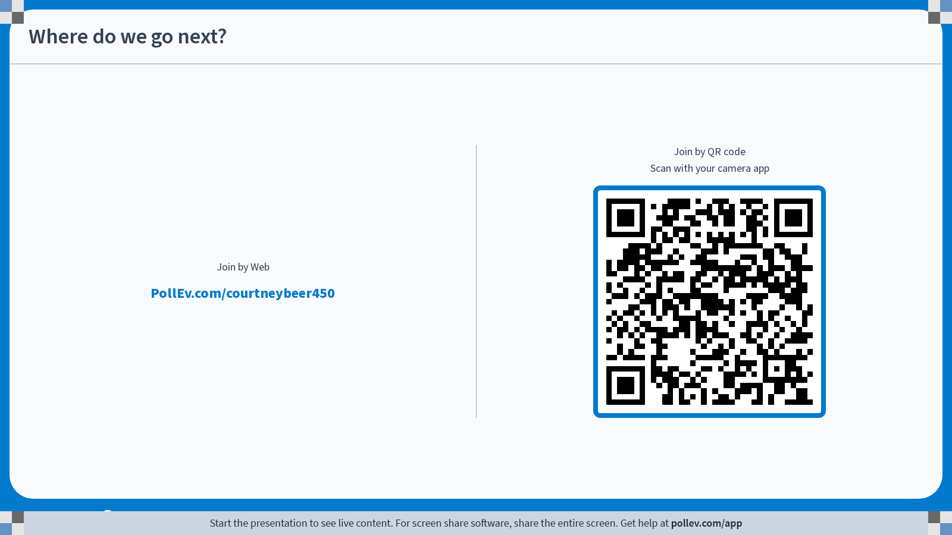
Notes:
Do not modify the notes in this section to avoid tampering with the Poll Everywhere activity.
More info at polleverywhere.com/support
Where do we go next?
https://www.polleverywhere.com/free_text_polls/sIrzPZKRdTn6CDH4ObKcy?display_state=chart&activity_state=opened&state=opened&flow=Engagement&onscreen=persist&hide=instructions

Slide 24
Sample of Key References (please email us for full list - cbeers@ou.edu)
Supporting Literature for ECE Expulsion & Suspension Data
Prevalence & Scope
American Academy of Pediatrics. (2023). Policy statement on expulsion and suspension in early childhood settings.
Giordano, K., Oh, Y., Stolovitz, R., & Calcagno-Davi, B. (2025). Expulsion from community childcare: Predictors and patterns across time. Early Childhood Education Journal.
Kelly, A. N., Xue, Y., & Gullo, D. F. (2024). Predicting child externalizing behavior ratings in Head Start: Investigating the impact of child and teacher influences. Early Childhood Research Quarterly, 68, 1-12.
Williams, J. L., & Yogman, M. W. (2023). Early childhood suspension and expulsion: A public health crisis. Pediatrics, 151(4).
Disparities & Disproportionality
Blacher, J., & Eisenhower, A. (2023). Preschool and child-care expulsion: Is it elevated for autistic children? Exceptional Children, 89(2), 178-196.
Hooper, A., & Schweiker, C. (2020). Prevalence and predictors of expulsion in home-based child care settings. Infant Mental Health Journal, 41(3), 411-425.
Sabol, T. J., Kessler, C. L., Rogers, L. O., et al. (2022). A window into racial and socioeconomic status disparities in preschool disciplinary action using developmental methodology. Annals of the New York Academy of Sciences, 1508(1), 123-136.
U.S. Department of Education Office for Civil Rights. (2016). 2013-14 Civil Rights Data Collection: A First Look.
Wymer, S. C., Corbin, C. M., & Williford, A. P. (2022). The relation between teacher and child race, teacher perceptions of disruptive behavior, and exclusionary discipline in preschool. Journal of School Psychology, 90, 33-42.
Impacts & Consequences
Glynn, L. M., Liu, S. R., Lucas, C. T., & Davis, E. P. (2024). Leveraging the science of early life predictability to inform policies promoting child health. Developmental Cognitive Neuroscience, 69, Article 101437.

