Slide 1




How are the children? Data on the status of families, communities, and children post-COVID.
Notes:
Today, I am presenting the aggregated results of the incredible work each of you as community contractors of the Know and Grow initiative completed between September 2023 and February 2024. My name is Tia Waldrop and I am with OSU’s Center for Family Resilience. We have the privilege and honor of working alongside the Potts Family Foundation Know and Grow team as evaluators and technical assistance providers of the Know and Grow initiative – a Potts Family Foundation-led initiative to build resilient children, families, and communities.
Today’s meeting is the first time the results from the aggregated analysis has been reported. We felt it was important for each of you to have the first look at the results of the research you conducted and reported. We want each of you to celebrate the work done and imagine how you might collaborate in responding to the results of your collaborative work.
As I present the results of this work, I encourage you as the experts in the room – to note similarities and differences in what is presented today and what you reported in your narratives. I invite you to reflect on the results of the work you bravely engaged in – and please let me know if you have any concerns that what was reported in your narrative is not represented – whether at all or incorrectly – and I’ll be sure to address such concern.
Feel free to make comments and ask questions in the chat - I'll do my best to make time in the end for responses.

Slide 2

Since 2020 hundreds of academic studies have researched the impact of the COVID era on children, parents, and communities.

Slide 3

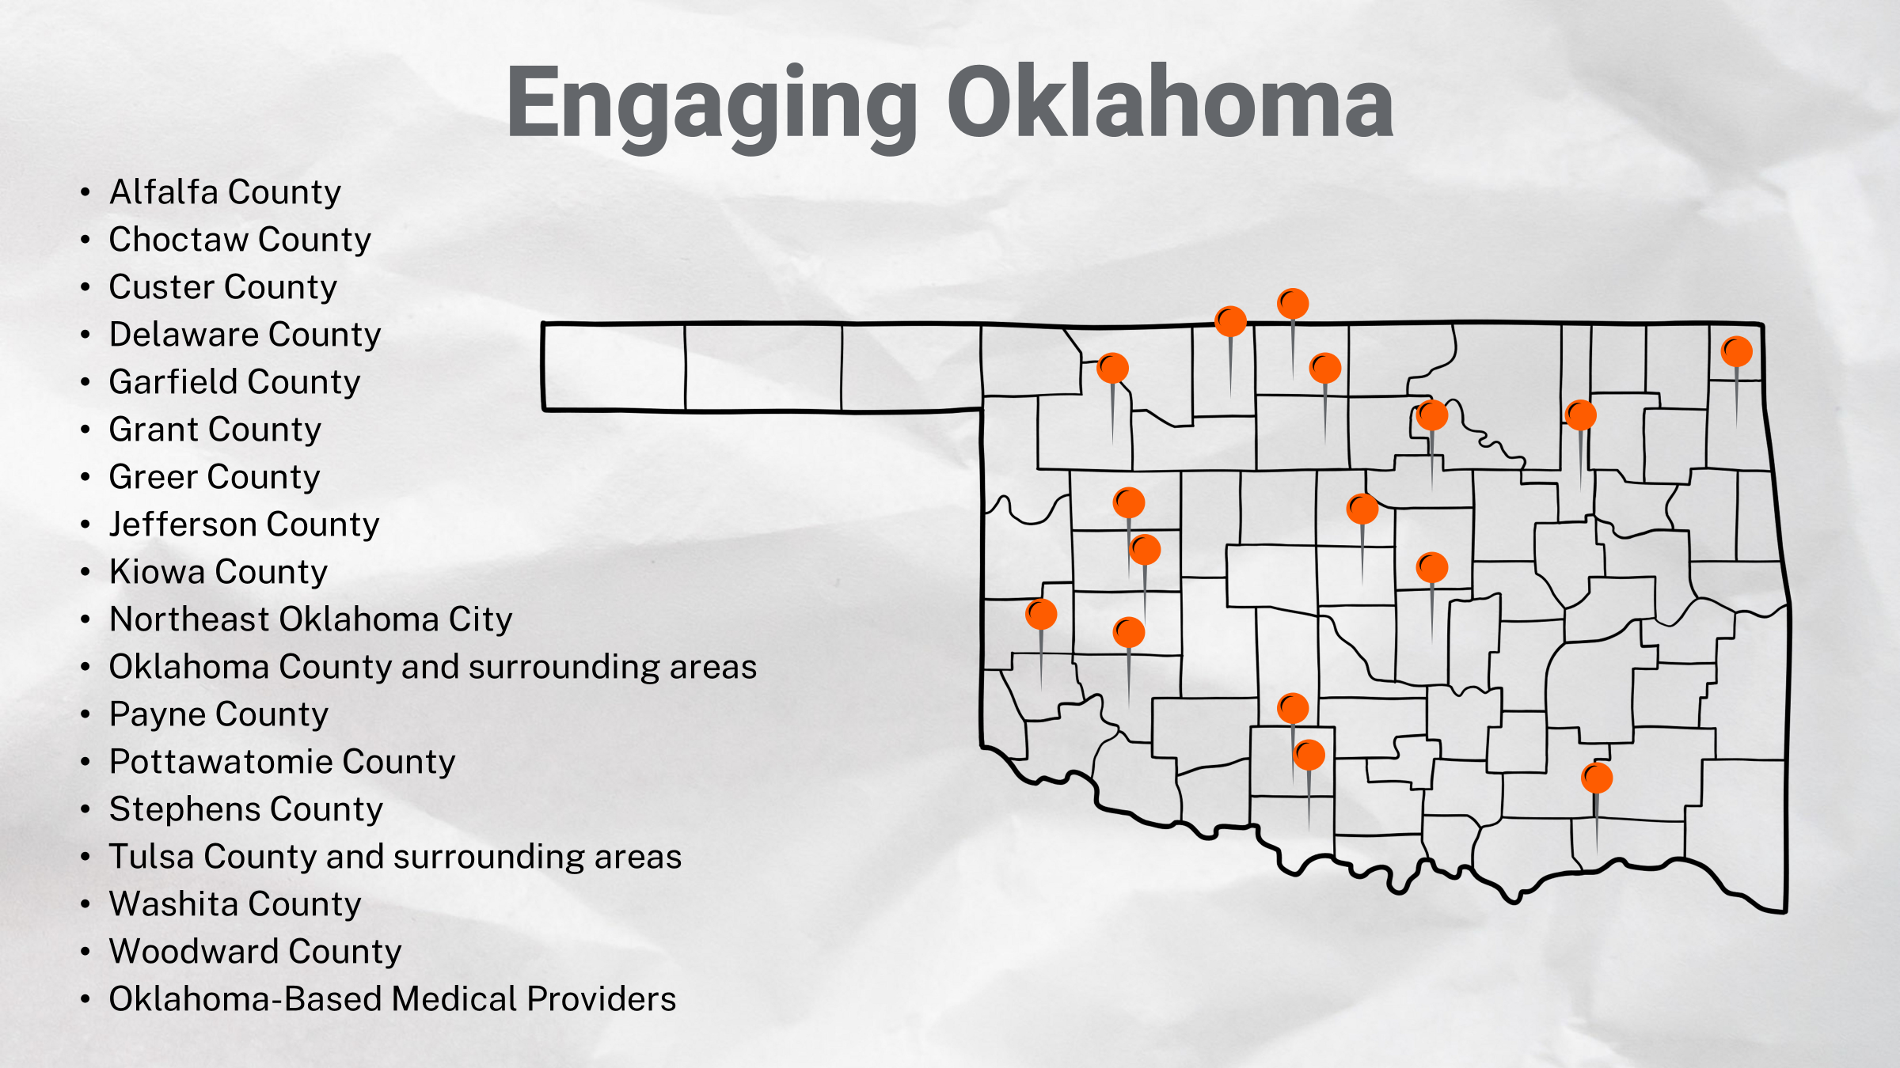

Slide 4




Engaging Communities
N=1,988
Survey Respondents
N=1,803
Focus Group Participants
N=163
Interviewees
N=22
Note: Not all narratives reported the sample size from which data was collected;
therefore, the actual numbers are likely higher than those presented here and elsewhere.
Notes:
Not all narratives reported the sample sizes of their data collection efforts.
Actual total sample size of KNG small contract research is likely higher than represented here and elsewhere

Slide 5
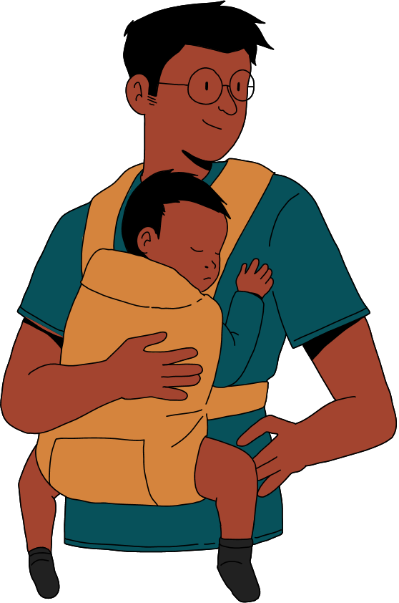

Engaging Communities
Parents/Caregivers
N=1,885
Providers*
N=103
*Early Childhood Educators, Mental/Behavioral Health Providers, Physicians/Nurse Practitioners, and Other

Slide 6
How are children born since mid-2019 and their families doing?
As informed by Oklahoma parents and caregivers

Slide 7

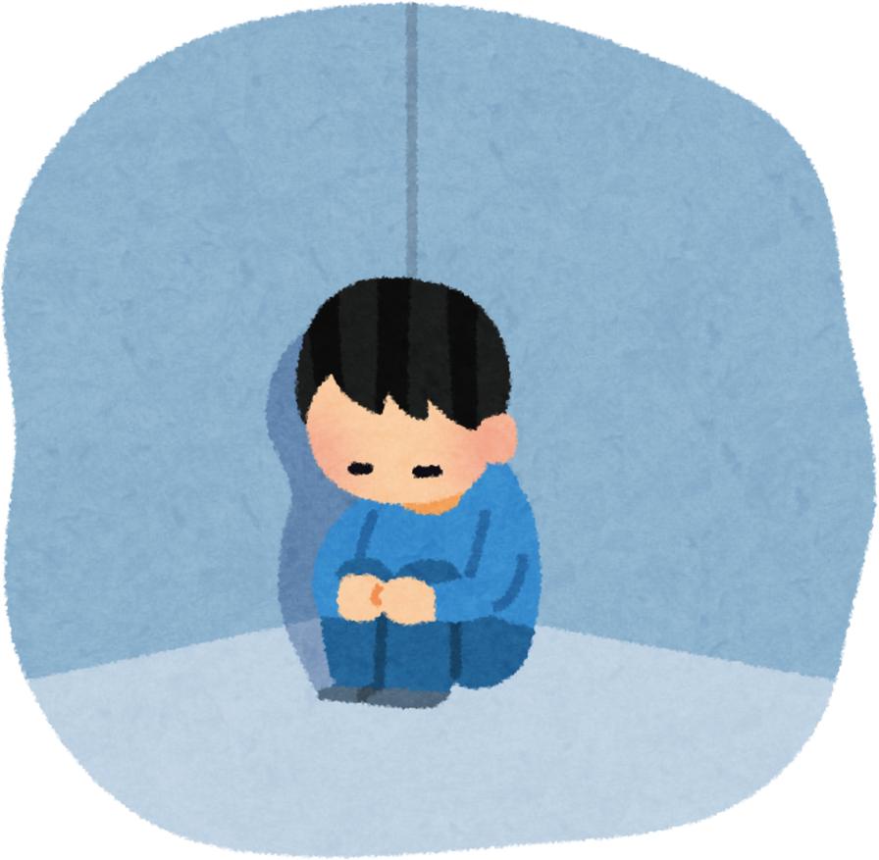

How are children born since mid-2019 doing?
Child Development Reports Mixed,
(social, motor, speech)
Child Isolation
Impacted Social and Language Skill Development
Child Screen Time Increased
Impacted Skill Development
Notes:
MIXED reports of concern for developmental delay and reports of developmental delay by parents/caregivers

Slide 8



How are parents of children born since mid-2019 doing?
Parents Social Support - Mixed, Parents Report Having Family Support, Yet Lack External Support
Parent Mental Health Issues Increased: PPA, PPD,
Anxiety, Depression, Stress, Alcohol/Substance Use, Worry
Parents Lack Awareness / Knowledge: Child Development and Community Resource Availability

Slide 9


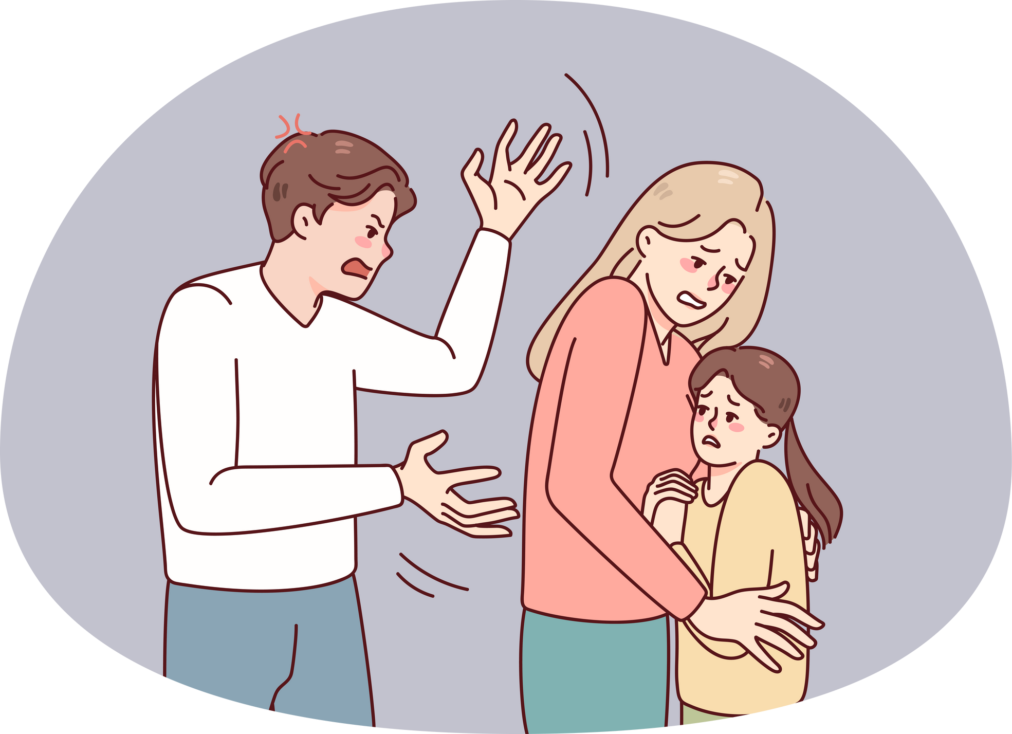
How are the families of children born since mid-2019 doing?
Family Togetherness Increased
Bonding, Support, and Stress
Increased Abuse in Home: IPV/DV, Increased Yelling, Hitting, or Shaking of Children by Parents
Family Stressors: Housing Instability, Inability to Meet Basic Needs, Social Benefits Cliff, Lack of Access to Services

Slide 10



What are care providers learning about the lives of children born since mid-2019?
Child Development
Delayed: Academic, Social, Speech, Behavior
Child Development
On Track to Meet Milestones
Child Screen Time Increased:
Used In Place of Parenting
Notes:
Notably, reports of developmental delay are mixed here too.

Slide 11
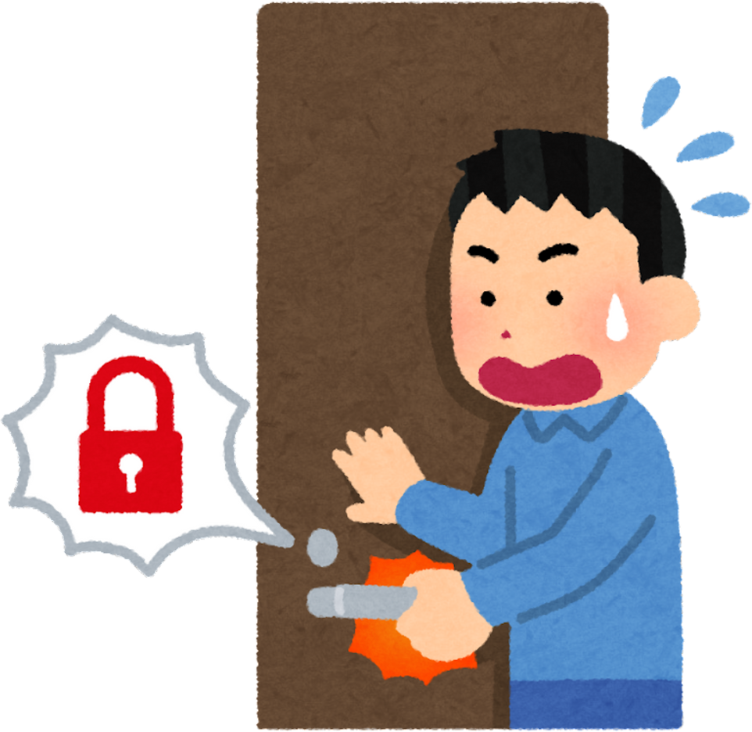

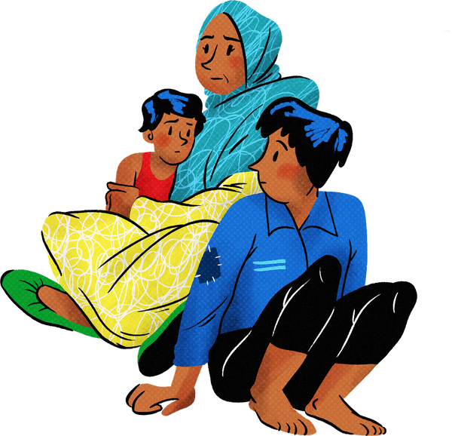
What are care providers learning about the lives of families with children born since mid-2019?
Families Experience Difficulty Accessing Resources and Services: Due to Family and Community-Level Barriers
Parent Mental Health Issues Increased: Anxiety, Depression, Substance Use, Stress
Financial Stressors: Families Are Not Able to Meet Basic Needs
Notes:
Notably, parents/caregivers and providers alike are reporting parent mental health issues, family financial stress, and difficulty for families to access services.

Slide 12
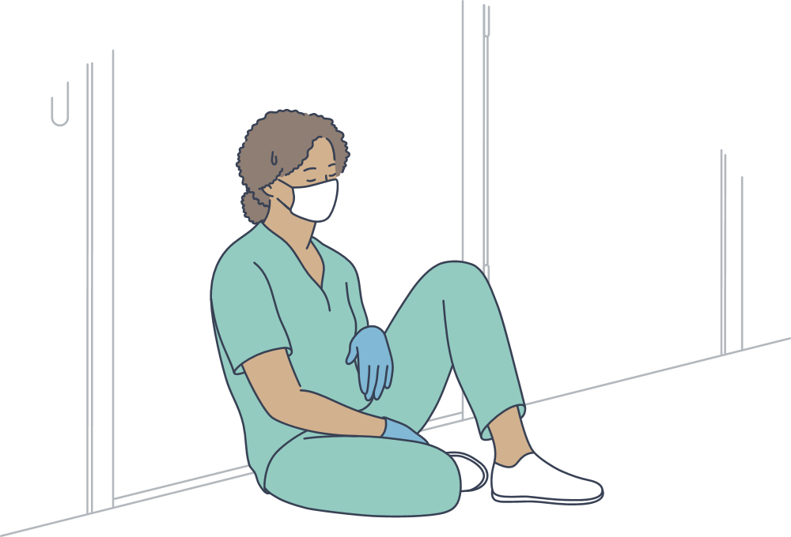


How is our community helping families and children to grow up safe, healthy, and skilled?
Access to Healthcare is Mixed
More Reports of Lack of Access
Access Unavailable: Childcare, Child Mental Health, Education, Mental Healthcare, Services for Children with Special Needs/Disabilities
Provider Caseloads Have Increased: Childcare/Educators, Medical Providers, Social Service Providers

Slide 13



How is our community helping families and children to grow up safe, healthy, and skilled?
Providers Report Increased Referrals for Services: Child Development, Mental Health
Need for Trained Professionals and Training for Professionals: Support Child Behavior, Medical Needs, Mental Health Needs
Providers Are Unaware of Community Resources for Families

Slide 14



How is our community helping families and children to grow up safe, healthy, and skilled?
Need for Child Development Supports: Increased Access to Developmental Screenings, Training
Awareness Campaigns Needed: Child Development, Parenting Practices, and Family Needs
Resources are Needed: Mitigate Social Benefits Cliff, Provide Access to Socialization for Children

Slide 15
Engaging Communities
9 Counties Surveyed
Washington
Jackson
Bryan
Muskogee
Grady
Pontotoc
LeFlore
Comanche
Logan
Focus Group Participants
Conducting now
With existing FRCs
Survey Respondents
N=1414
Notes:
Not all narratives reported the sample sizes of their data collection efforts.
Actual total sample size of KNG small contract research is likely higher than represented here and elsewhere

Slide 16
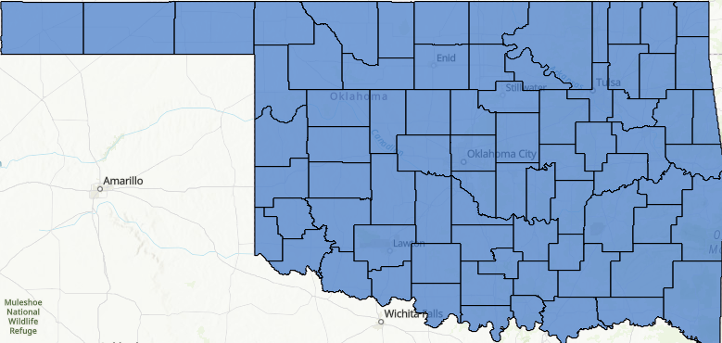


5 minutes survey deployed at community events.

Slide 17
What are the next steps that should be taken by and within Oklahoma communities?
As informed by Community Contractors

Slide 18

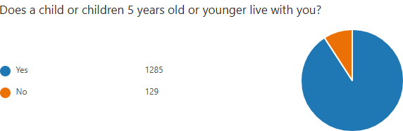

Slide 19
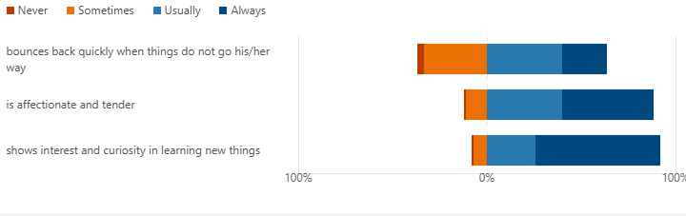

Slide 20
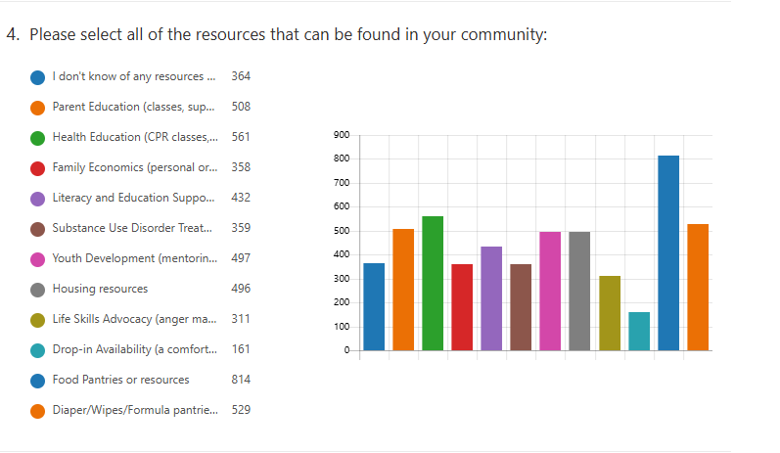

Slide 21
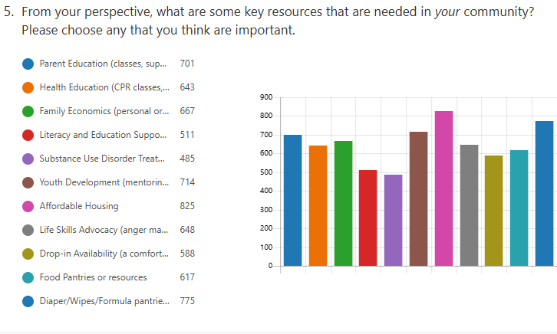

Slide 22



Community Next Steps
Focused Resources* and Supports for Children, Providers, and Families
Increase Access to Existing and New Community Resources*
Community-Based Initiatives: Awareness Campaigns, Training, Family-Focused Programming
*Child development, referrals, childcare, commensurate salary, healthcare, MH care, training
Notes:
Awareness initiatives, education and outreach, psychoeducation etc. for parents, coupled with the need for supporting provider competencies around key issues demonstrates the importance of building a network around these communities – to include both families and providers – to share knowledge, provide support, and expand social and professional networks – (momentum already with the early relational health core and the self-healing communities work that many of you are part of through) – the data seems to be reinforcing the value and utility of those efforts.

Slide 23



Asset Based Community Development
Everyone Has Gifts
Relationships build a community
Development should start with what you have
Notes:
Developed by John McKnight and John Kretzman

Slide 24
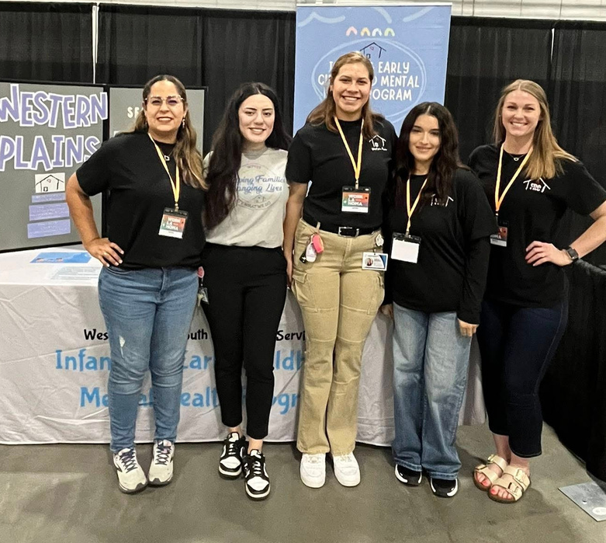
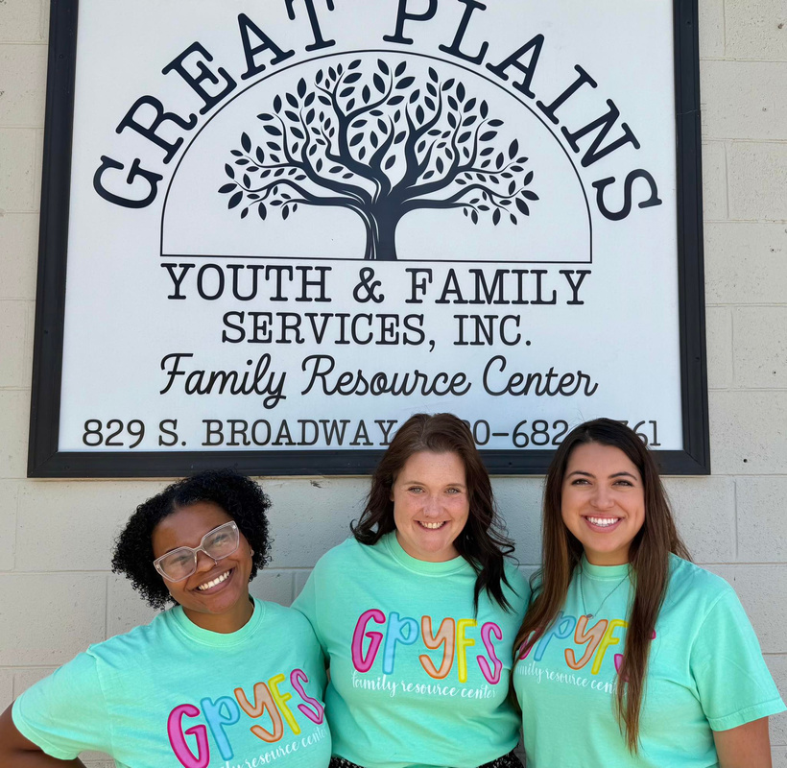
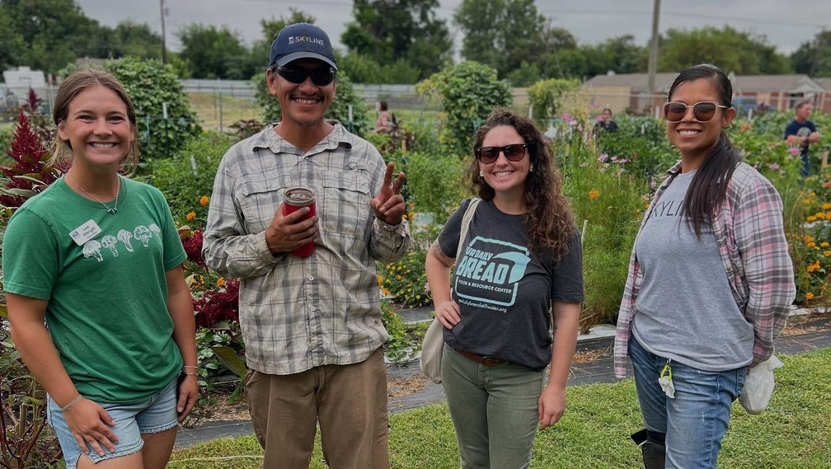
FAMILY RESOURCE CENTERS
Grounded in a tangible family need:
Diaper banks, Food banks, After school care, Childcare, Health providers
where is not important - relationships are key

Slide 25
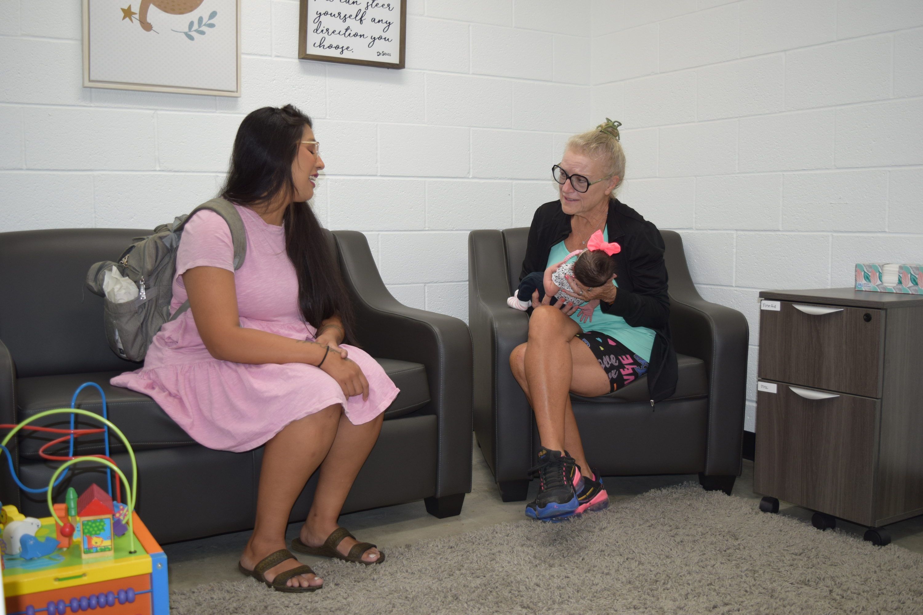
WHAT IS AN FRC?
Builds communities of peer support for families to develop social connections
Staffed with experts on navigating the network of support in the community
Developed with parents; not for them

Slide 26
Strengths Based
Trauma-informed

Slide 27
Evaluations in Colorado revealed significant gains in family economic self-sufficiency, health, and resilience over a nine month period.
Research & Evaluation – Family Resource Center Association

Slide 28
A longitudinal study in a rural Western U.S. county found that every $1 invested in the FRC yielded $2.92 in savings to the child welfare system.
Other studies report ROI figures a high as $4.93 per dollar invested, with reductions in out-of-home placements and child abuse cases.
Bayless, S., Ariza, A., Richmond, M. & Pecora, P.J. (2025).Returns on investment of a familyresource center to the child welfare system: Estimates from a quasi-experimental study from thewestern United States.Family Justice Journal,Vol. 22, 10-16. Retrieved fromhttps://www.thefamilyjusticegroup.org/

Slide 29
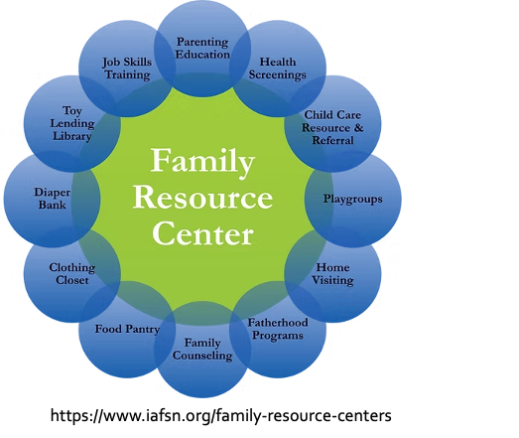



Slide 30
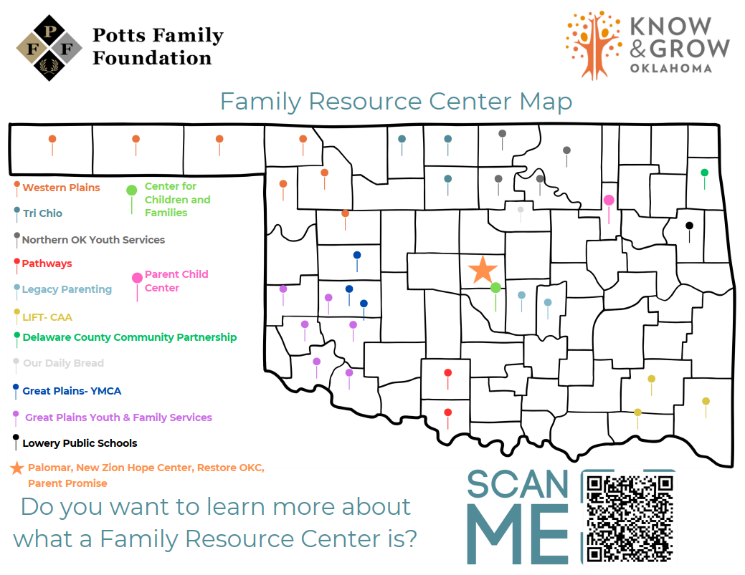

Slide 31

Many thanks

Slide 32

Contributors:
Tia Waldrop, PhD, PI
Lana Beasley, PhD
Brooke Tuttle, PhD, Co-I
Haley Hall, MS
Hannah James, MS
Sage Murray
Divanny Perez
AJ Griffin, EdD
ajgriffin@pottsfamilyfoundation.org
405-834-0782
cfr@okstate.edu

